Slide 1
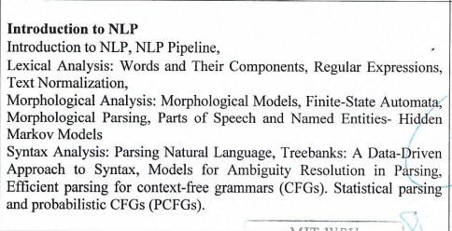
Unit 2

Slide 2
Natural Language Processing
Natural Language Processing (NLP) refers to the branch of computer science—and more specifically, the branch of artificial intelligence concerned with giving computers the ability to understand text and spoken words in much the same way human beings can.
NLP combines computational linguistics—rule-based modeling of human language—with statistical, machine learning, and deep learning models. Together, these technologies enable computers to process human language in the form of text or voice data and to ‘understand’ its full meaning, complete with the speaker or writer’s intent and sentiment.

Slide 3
Natural Language Processing (contd)
NLP drives computer programs that translate text from one language to another, respond to spoken commands, and summarize large volumes of text rapidly—even in real time.
One may have interacted with NLP in the form of
voice-operated GPS systems,
digital assistants,
speech-to-text dictation software,
customer service chatbots, and
other consumer conveniences.
But NLP also plays a growing role in enterprise solutions that help streamline business operations, increase employee productivity, and simplify mission-critical business processes.

Slide 4
NLP tools and approaches

Slide 5
Python and the Natural Language Toolkit (NLTK)
The Python programing language provides a wide range of tools and libraries for attacking specific NLP tasks. Many of these are found in the Natural Language Toolkit, or NLTK, an open source collection of libraries, programs, and education resources for building NLP programs.
The NLTK includes libraries for many of the NLP tasks listed above, plus libraries for subtasks, such as sentence parsing, word segmentation, stemming and lemmatization (methods of trimming words down to their roots), and tokenization (for breaking phrases, sentences, paragraphs and passages into tokens that help the computer better understand the text).
It also includes libraries for implementing capabilities such as semantic reasoning, the ability to reach logical conclusions based on facts extracted from text.

Slide 6
2) Statistical NLP, machine learning, and deep learning
The earliest NLP applications were hand-coded, rules-based systems that could perform certain NLP tasks, but couldn't easily scale to accommodate a seemingly endless stream of exceptions or the increasing volumes of text and voice data.
Statistical NLP combines computer algorithms with machine learning and deep learning models to automatically extract, classify, and label elements of text and voice data and then assign a statistical likelihood to each possible meaning of those elements.
Today, deep learning models and learning techniques based on convolutional neural networks (CNNs) and recurrent neural networks (RNNs) enable NLP systems that 'learn' as they work and extract ever more accurate meaning from huge volumes of raw, unstructured, and unlabeled text and voice data sets.

Slide 7
NLP
NLP is a set of techniques / methods / processes to extract meaning from text
NLP techniques have to look at words, phrases, sentences, paragraphs, documents …… in that order.
Challenges in NLP
Ambiguity in Natural languages
e.g.
( computers can not process ambiguity – deterministic in nature – NFA/DFA, tractable problems)
Understanding syntax / Grammar
Understanding Semantics

Slide 8
Role of NLP in CS
Natural Language Processing is a form of AI that gives machines the ability to not just read, but to understand and interpret human language.
With NLP, machines can make sense of written or spoken text and perform tasks including speech recognition, sentiment analysis, and automatic text summarization

Slide 9
Why is NLP important?
Large volumes of textual data
Natural language processing helps computers communicate with humans in their own language and scales other language-related tasks. For example, NLP makes it possible for computers to read text, hear speech, interpret it, measure sentiment and determine which parts are important.
Today’s machines can analyze more language-based data than humans, without fatigue and in a consistent, unbiased way. Considering the staggering amount of unstructured data that’s generated every day, from medical records to social media, automation will be critical to fully analyze text and speech data efficiently.

Slide 10
2. Structuring a highly unstructured data source
Human language is astoundingly complex and diverse. We express ourselves in infinite ways, both verbally and in writing. Not only are there hundreds of languages and dialects, but within each language is a unique set of grammar and syntax rules, terms and slang. When we write, we often misspell or abbreviate words, or omit punctuation. When we speak, we have regional accents, and we mumble, stutter and borrow terms from other languages.
While supervised and unsupervised learning, and specifically deep learning, are now widely used for modeling human language, there’s also a need for syntactic and semantic understanding and domain expertise that are not necessarily present in these machine learning approaches.
NLP is important because it helps resolve ambiguity in language and adds useful numeric structure to the data for many downstream applications, such as speech recognition or text analytics.

Slide 11
NLP Pipeline

Slide 12
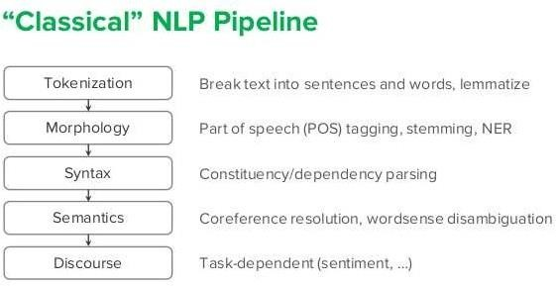
D1

Slide 13
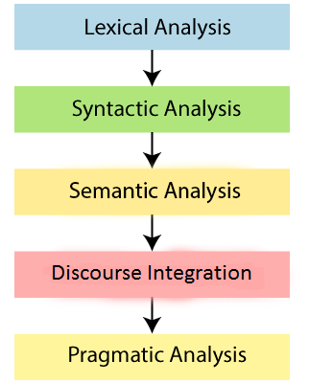
NLP Pipeline

Slide 14
Lexical Analysis
Lexical analysis separates tokens from the language statements based on “Pattern Matching Principle”.
A token (string of characters) is the smallest unit with some logical meaning, which cannot be further decomposed.
Regular expression is used to specify text strings in all sorts of text processing and information extraction applications.
“Finite State Automata” is a basic mathematical foundation used extensively in Computational Linguistics.
Variations / different forms of Finite state automata – state transducers, HMM, N grams

Slide 15
Regular Expression (RE)
RE is a Language for specifying text search strings
RE is an algebraic notation for characterizing a set of strings/ sequence of symbols
RE can be used to define a Language in a formal way
Eg. Variable name in a programming language L(L|D|S)*
a, abc, a10, min_count, ….
here L -> {a..zA..Z}
D -> {0..9}
S -> {$|_}
Eg. A person’s name in a Natural language L1L*
M, Vrushali, John,…..
here L -> {a..z}
L1 -> {A..Z}

Slide 16
Searching using RE
Searching needs a “pattern” to be searched and a “corpus” of text to search through.
A pattern is “RE” and a corpus can be an array / temporary storage / buffer where text from document can be stored temporarily for processing.
Eg. In web search engine, the corpus can be entire document or web page
In Language translation, corpus can be a single statement
For atomizing the “Token Recognition” process, we can represent RE using state diagram L1 L
0 1

Slide 17
RE – NFA - DFA
Pattern / RE
(a/b)*abb all strings like abb, aabb, ababb, babb, ……….can be recognized
What are NFA, DFA?

Slide 18
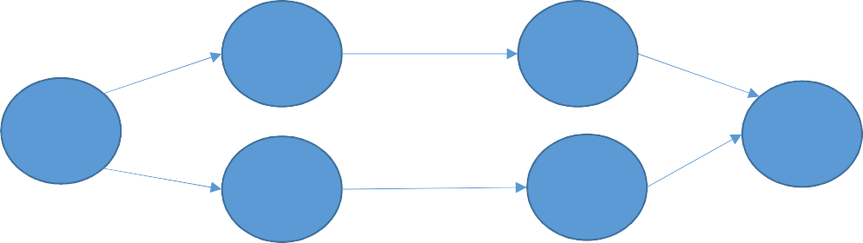
RE to NFA
(a/b)*abb
For a
For b
b
1
a
2
3
4
For a/b
ε
1
a
2
ε
0
5
3
4
ε
ε
b

Slide 19
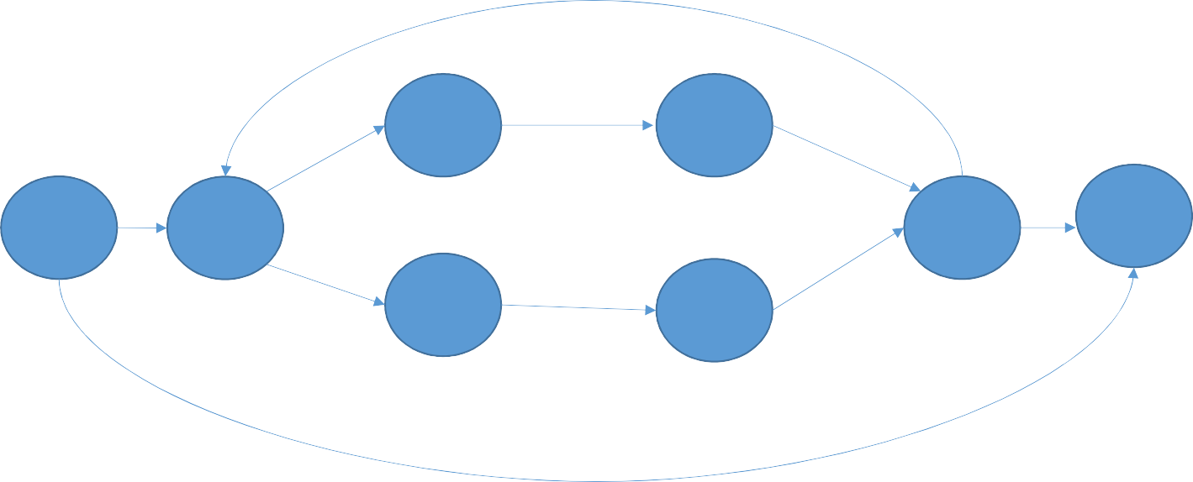
For (a/b)*
ε
a
ε
2
3
ε
0
ε
1
6
ε
7
ε
4
5
ε
b
ε

Slide 20
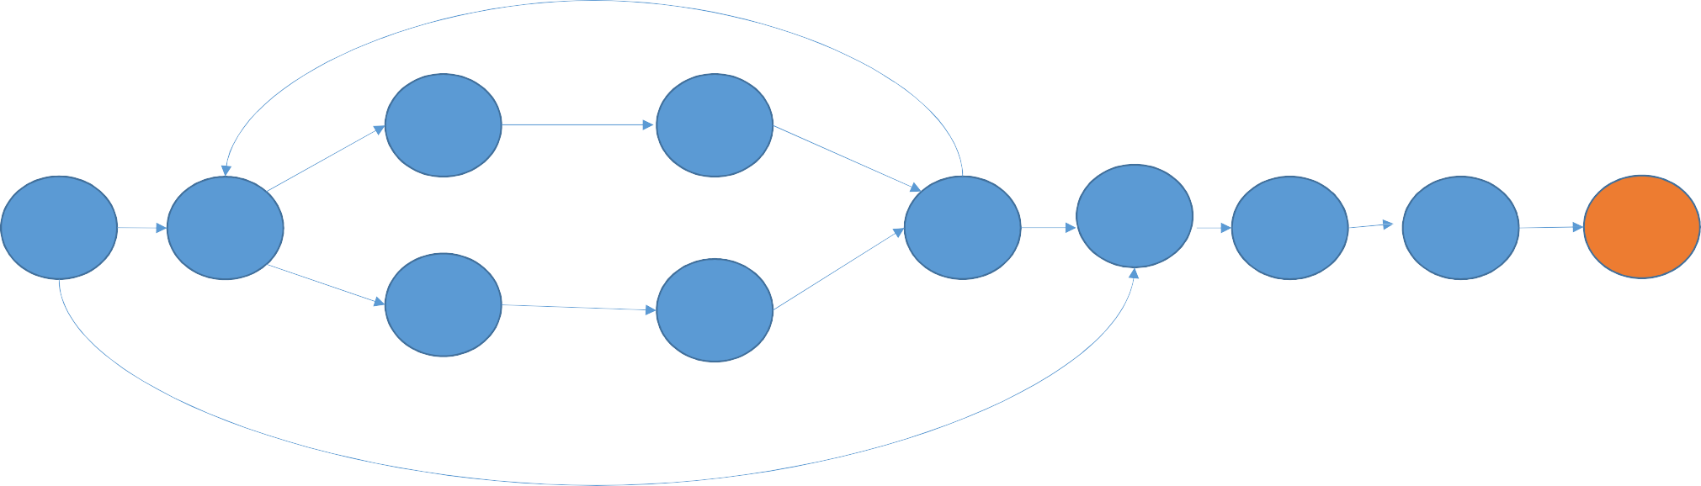
ababb
ε
a
ε
2
3
ε
ε
ε
a
b
b
0
1
6
7
8
9
10
ε
4
5
ε
b
ε

Slide 21
NFA to DFA
Start state of DFA:
State A = epsilon closure (0) = {0,1,2,4,7}
From A on input a:
B = epsilon closure (3,8) = {1,2,3,4,6,8}
From A on input b:
C = epsilon closure (5) = {1,2,4,5,6,7}
From B on input a:
D = epsilon closure (3) = {1,2,3,4,6,7}
From B on input b:
C= epsilon closure (5,9) = {1,2,4,5,6,7,9}
State | Input a | Input b
A | B | C
B | D | C
C
D

Slide 22
From C on input a:
B = epsilon closure (3,8) = {1,2,3,4,6,8}
From C on input b:
E = epsilon closure (5,10) = {1,2,4,5,6,10}
From D on input a:
D = epsilon closure (3) = {1,2,3,4,6}
From D on input b:
C = epsilon closure (5) = {1,2,4,5,6,7}
From E on input a:
D = epsilon closure (3) = {1,2,3,4,6,7}
From E on input b:
C = epsilon closure (5) = {1,2,4,5,6,7}
State | Input a | Input b
A | B | C
B | D | C
C | B | E
D | B | C
E | D | C

Slide 23
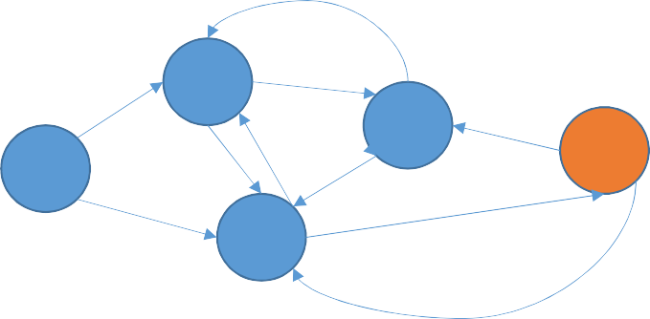
Input string
abb aaabb
aaabbbabb
aabc
State | Input a | Input b
A | B | C
B | D | C
C | B | E
D | B | C
E | D | C
a
a
B
a
D
a
A
b
a
E
b
b
C
b
b

Slide 24
Pattern recognition using Nondeterministic FSA (NFSA)
How to handle non-determinism:
Backup (Backtrack) - we should have a marker in the input to track where we were in the input and in which state of the automata … if we take a wrong choice
Look-ahead – we should look ahead in the input to decide which path / alternative to take
Parallelism – execute every alternative path in parallel

Slide 25
Morphological Analysis / Parsing
What is a “morpheme”?
A minimal meaning-bearing unit in a language eg. Dog -> 1 morpheme ‘dog’
cats -> 2 morphemes ‘cat’ + ‘s’
The problem of recognizing that a word breaks down into component morphemes and building a structural representation of this fact is known as “Morphological Analysis / Parsing”
eg. doctors – doctor + s
foxes – fox + es
talking –
(surface / input forms)
talk + ing
(stem) (suffix)

Slide 26
Different surfaces can have same stem
eg. sings, sang, sung -
surfaces
sing
stem / common lemma
Mapping from surfaces to stem / lemma is also called “Lemmatization”
Stemming – simple to implement, useful in applications like IR and Web search
Lemmatization – complex to implement, NLP applications which relies on meaning
Can the problem of morphological analysis be solved by Lookup?
may be possible for a small subset but not for entire language
1 verb – various forms
1 noun – various forms
Some languages are morphologically complex – Russian, Turkish

Slide 27
Morphemes
Morphemes
Stems
Affixes
Prefix Precedes stem
Suffix Follows stem
Infix Inserted inside
stem
Circumfixes Precedes + follows stem
More than one affixes in the same word are possible Eg. Rewrites, preprocessing

Slide 28
Methods / Approaches to combine morphemes to from words
Inflection – combination of a word stem with a grammatical morpheme, commonly plural with ‘s’ or past tense with ‘ed’, resulting in a word of same class
eg. Papers, walked
Derivation – combination of a word stem with a grammatical morpheme resulting in a word of different class
eg. fish → fisherry, computerize -> computerization
Compounding – combination of multiple word stem together eg. Battlefield, doghouse
Cliticization – combination of a word stem with a “clitic”
eg – I’hv I’ll I’m
A clitic is a morpheme that acts syntactically like a word but is reduced in the form and attached to another word

Slide 29
Inflectional Morphology
In English language, only nouns, verbs and adjectives are inflected
Nouns can be inflected in two way –
affix used for plural
affix used for possessive
 | Regular nouns |  | Irregular nouns
Singular | cat | box | mouse | ox
Plural | cats | boxes | mice | oxen
Possessive suffix is realized by apostrophe + s
Eg for singular noun – child’s
for plural - students’

Slide 30
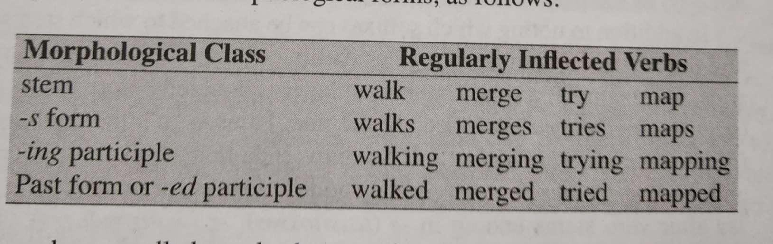
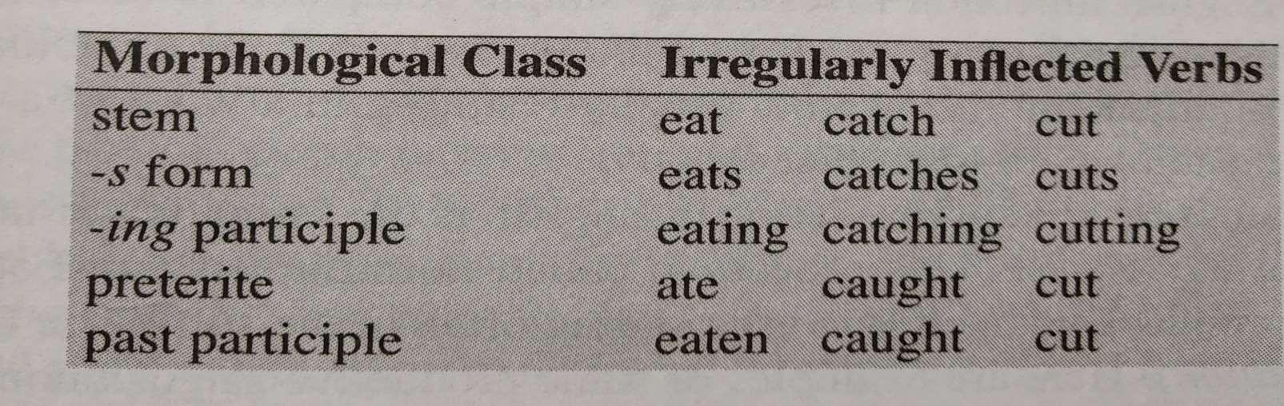
Verbs
Verbal inflection in English language is more complex
Regular and irregular classes of verbs
Majority of the verbs are in regular class
While adding suffixes, spelling changes are taking place at morpheme boundaries.
Eg beg – begged
toss – tosses

Slide 31
Derivational Morphology
It is a combination of a word stem with a grammatical morpheme, resulting in a word of
different class.
A common derivation in English is formation of new noun, from verb or adjective – the process is called as “nominalization”
Suffix | Base verb / adj | Derived noun
-ee | Appoint (v) | Appointee
-er | Kill (v) | Killer
-ness | Fuzzy (a) | Fuzziness
Adjectives can be derived from word or noun
 | Base Noun / Verb | Derived Adj
-able | Suit (v) | Suitable
-less | Clue(n) | clueless

Slide 32
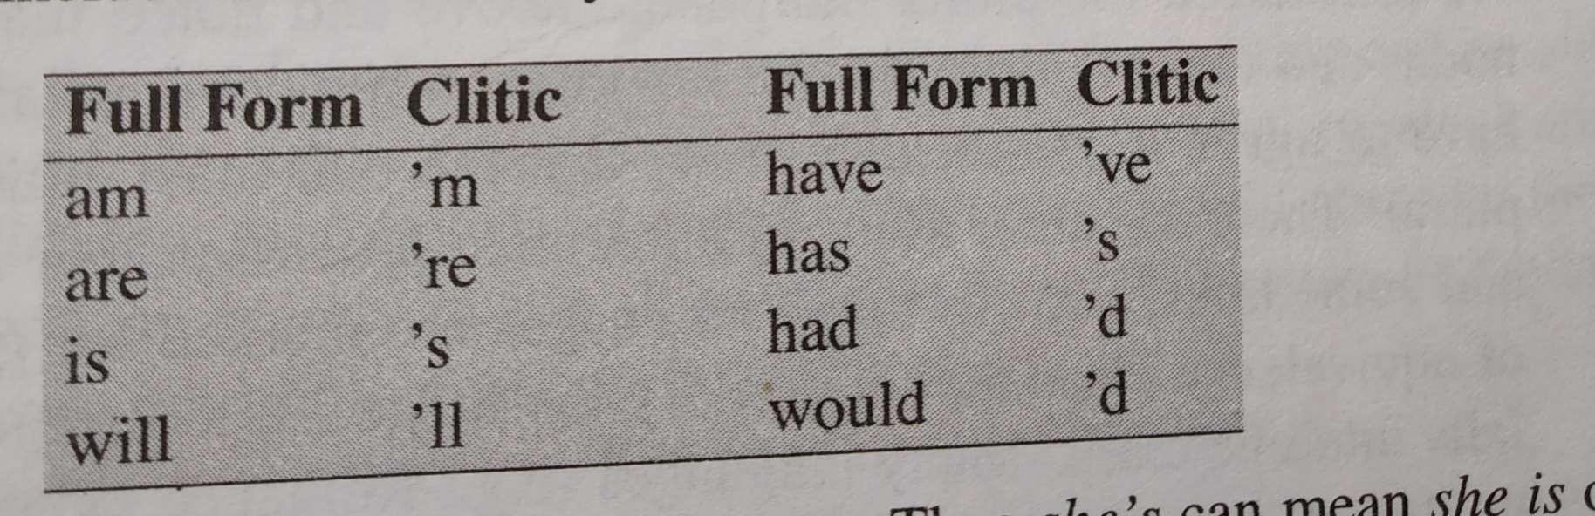
Cliticization
Clitics preceding a word are Proclitics
Clitics following a word are Enclitics
These are rarely found in English

Slide 33
Finite state morphological analysis / parsing
What is expected in morphological analysis?
Input | Morphological Parse
Cats | Cat + N + Pl
Cities | City + N + Pl
Caught | Catch + V + Past | Catch + V + PastParticiple
Dog | Dog + N + SG
Playing | Play +V + PresPart
ambiguity

Slide 34
How to build a Morphological parser?
Lexicon
Lexicon is a list of stems and affixes along with basic information (whether a stem is a noun or verb)
Morphotactics
These are guiding rules for arrangement of morphemes from different classes eg. Morphemes of which class can follow morphemes of other class
boy – boyes
girl – girls here ‘es’ and ‘s’ follow the nouns, they can not precede the noun
Orthographic rules
Spelling rules – they guide about the changes occurring in a word stem while combining with other morphemes eg. City – cities ……not citys

Slide 35
Exercise
Represent morphological parse of following words.
Input | Morphological Parse
patents
balloons
watched
animal
going

Slide 36
Morphological parse
Input | Morphological Parse
patents | patent + N + Pl
balloons | balloon + N + Pl
watched | watch + V + Past
animal | animal + N + SG
going | go +V + PresPart

Slide 37
Construction of a Finite-State lexicon
Simplest possible Lexicon –
every possible word in a language + proper names
{apple, boxes, cat, ……, go, run, stop, running, gone…..Ameya, Bharati, ……….. }
Impossible task
Hence, Lexicons are built with the list of each of the stems and affixes of the language together with the representation of morphotactics

Slide 38
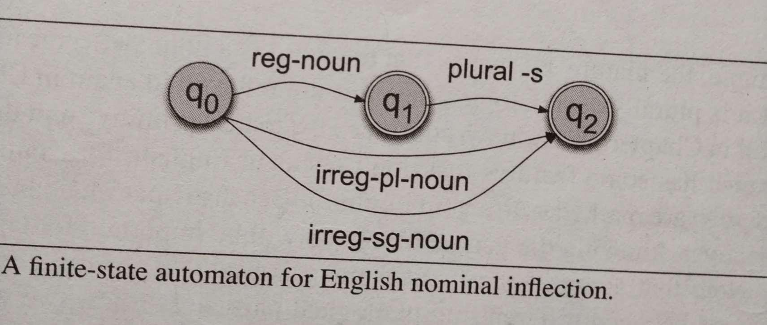

Eg. Cat, dog, ….majority of nouns fall under reg-noun category.
Ignore plurals with -es
Reg-noun | Irreg-Pl-noun | Irreg-SG-noun | Plural -s
Cat | Geese | Goose
Dog | Sheep | Sheep
Girl | Mice | mouse

Slide 39
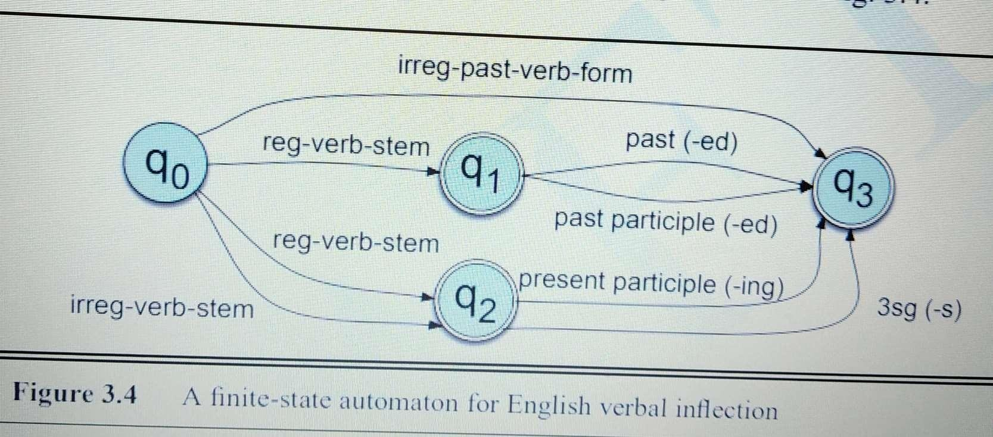
English verbal Inflection
3 forms of verb stem class –
Regular verb stem Irregular verb stem Irregular past verb form
Affix class –
-ed past
-ed participle
-ing participle
-s Third singulars
Reg-verb- stem | Irreg-verb- stem | Irreg-past- stem | Past –ed | PastPart – ed | Pres Part – ing | Third singular -s
walk | cut | caught
fly | speak | ate
talk | sing | sang

Slide 40
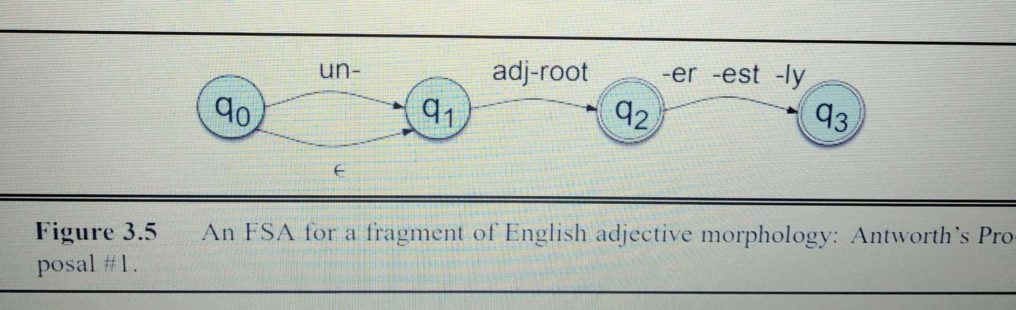
Derivational Morphology
Simple ex for morphotactics of English adjectives Big – bigger, biggest
Happy – happier, happiest, happily, unhappy, unhappily
Cool – cooler, coolest, coolly

Slide 41
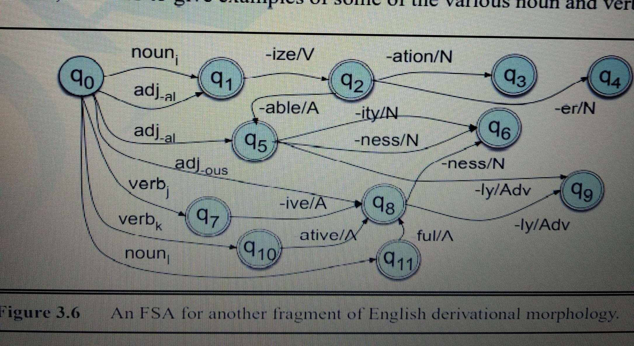
Exercise

Slide 42
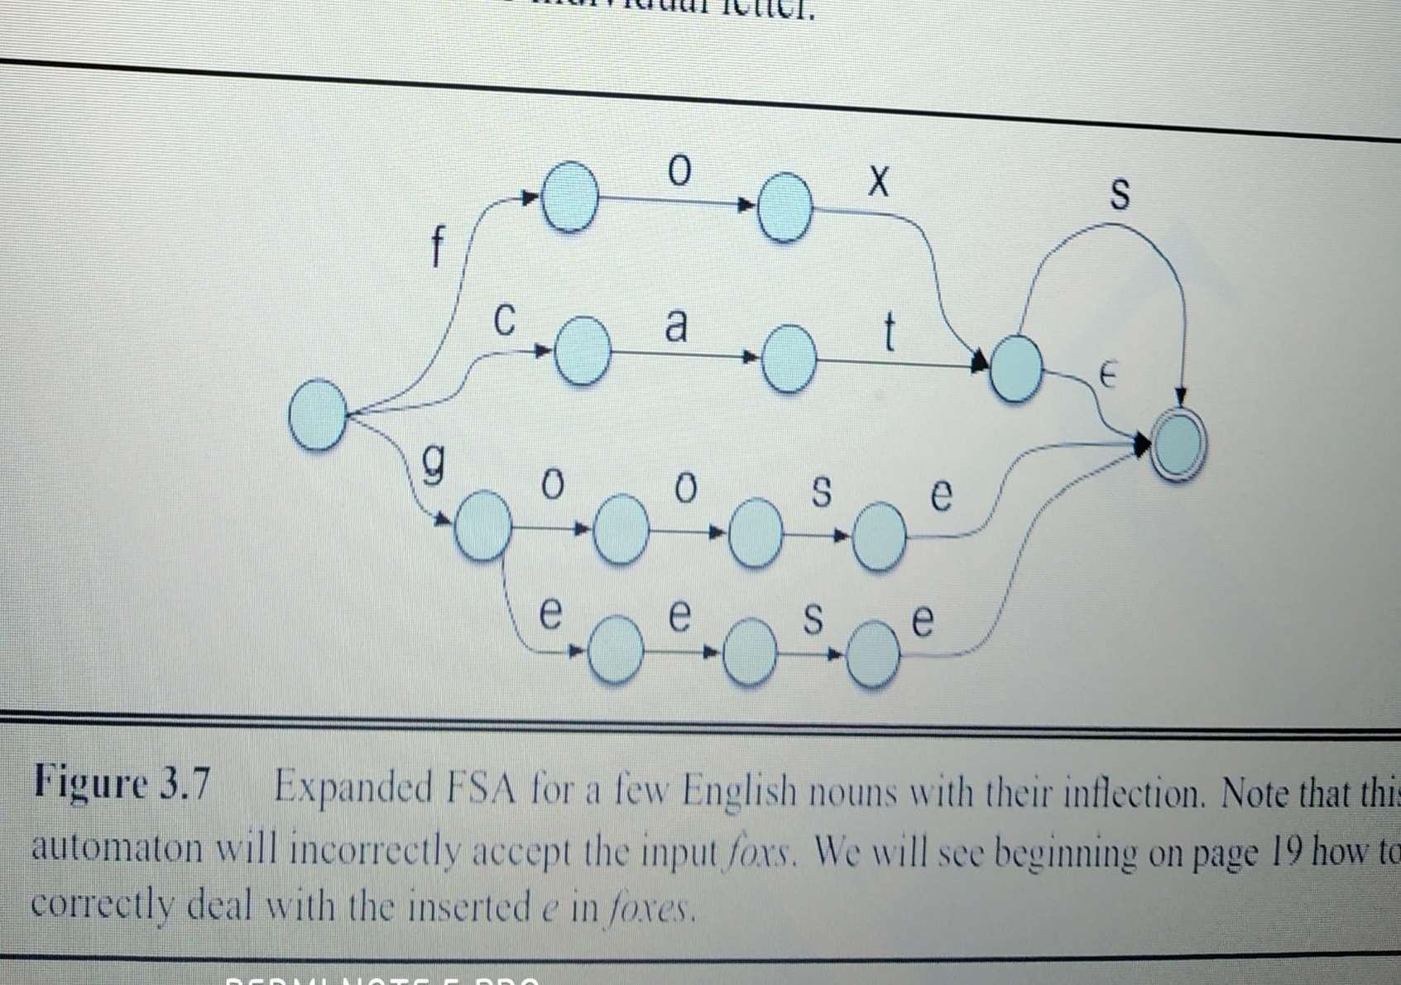
Morphological recognition – plug sub-lexicon into FSA ie. Expand each arc like reg-noun, irreg-pl-noun etc.

Slide 43
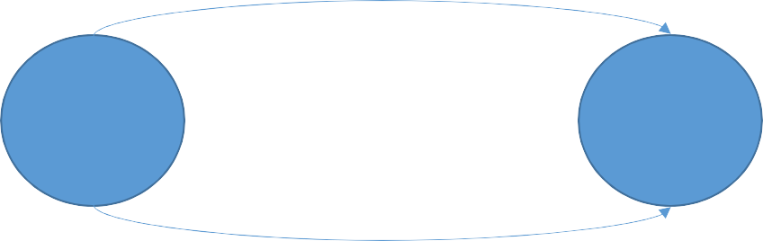
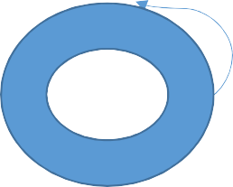
Finite State Transducer (FST)
A sophisticated tool that is used for understanding and transforming language.
Digital language magician; it takes in words, sentences, or even entire paragraphs and performs all sorts of clever tricks with them.
FSTs are like the secret sauce behind many NLP applications, from auto-correcting your typos to helping virtual assistants understand what you're asking them to do.
q0
q1
aa : b
b : a
b : ε
b : b
FST as recognizer
FST as generator
FST as translator
FST as set relator
b : ba
FST as a morphological parser will take as input a string of letters and generate as output a string of morphemes

Slide 44
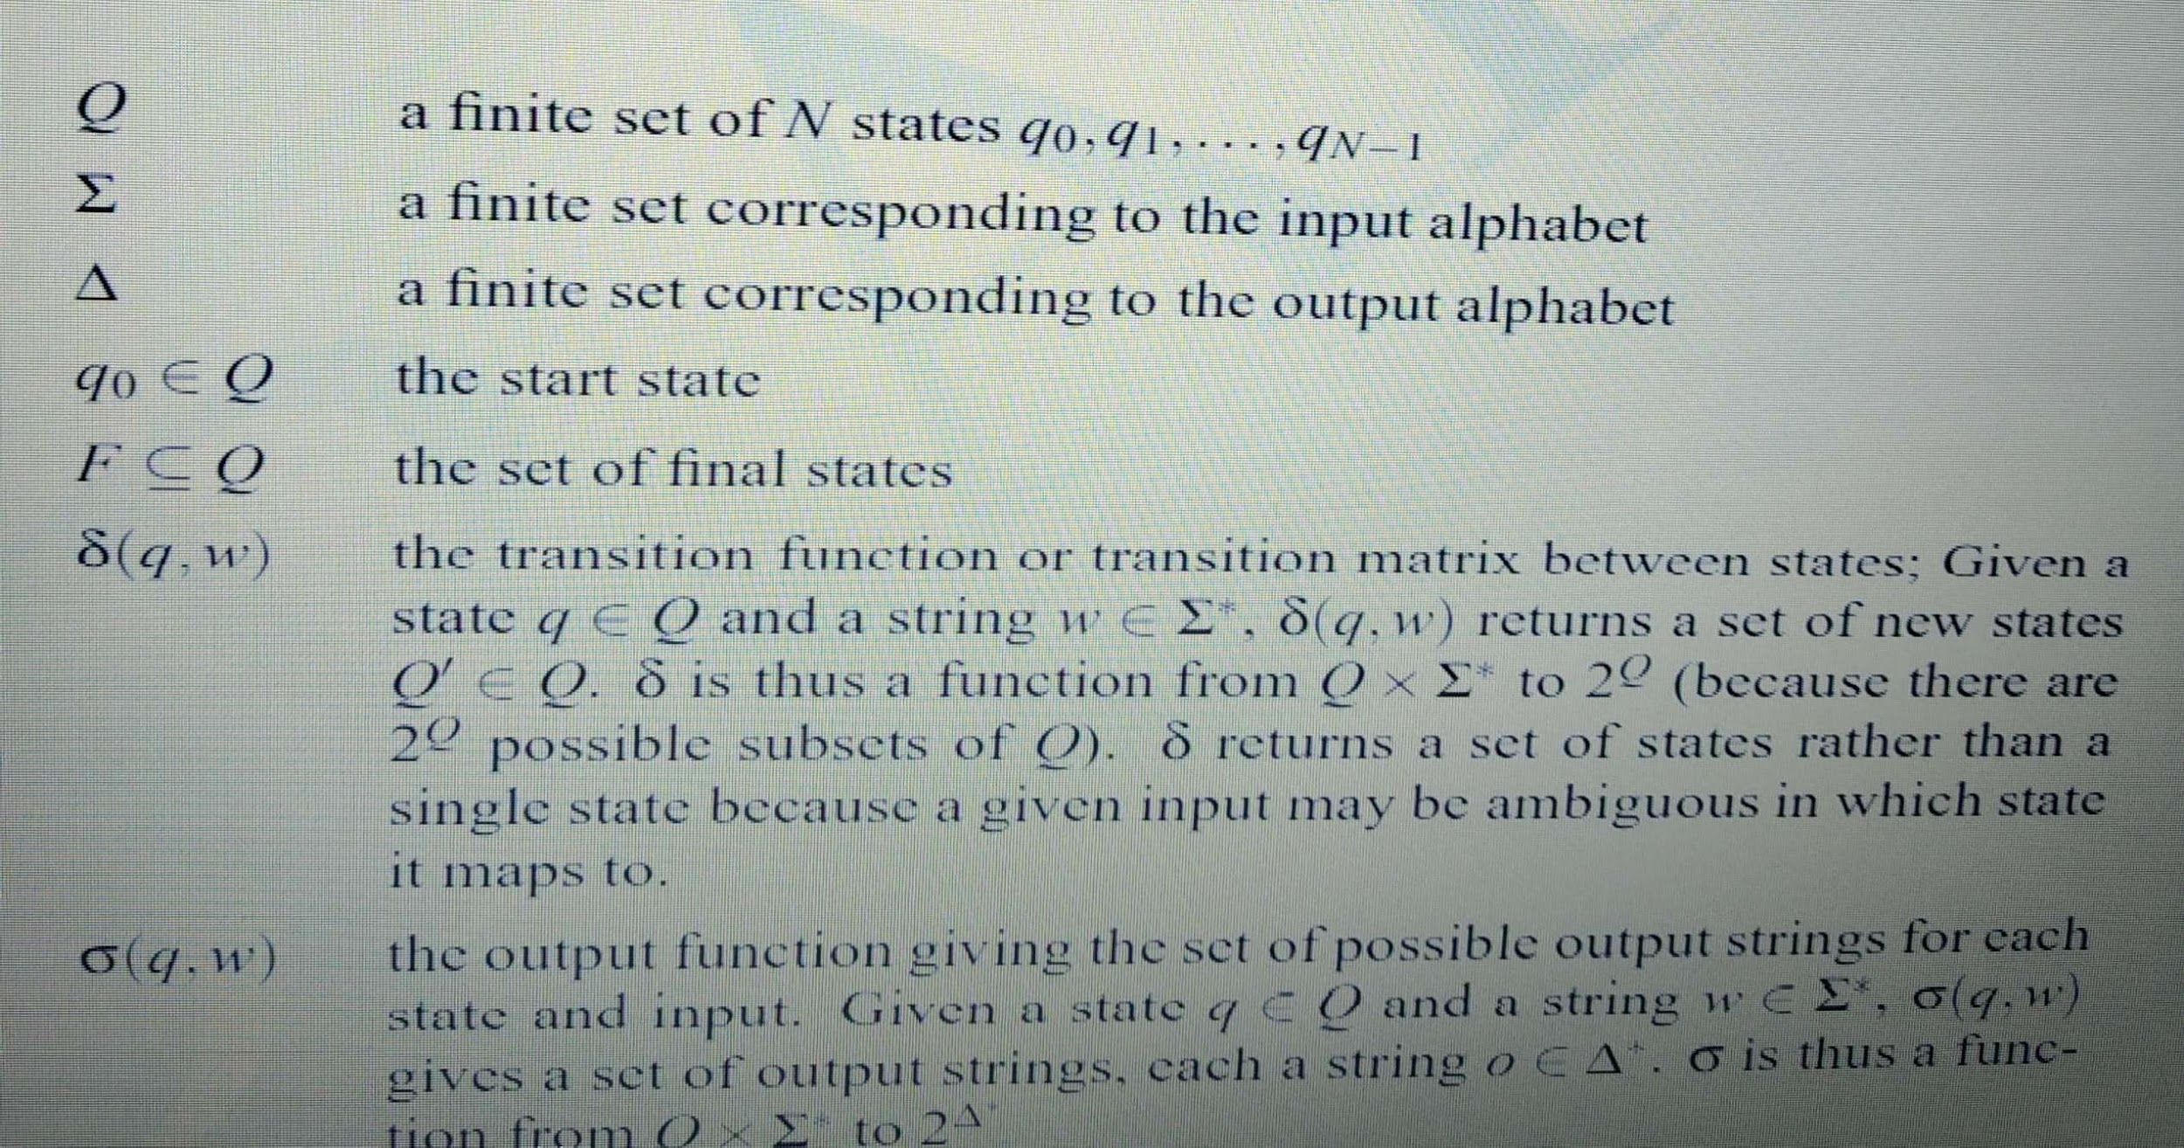
FST representation

Slide 45
FST - for morphological parsing
For given input cats – cat + N +Pl
Here a word is represented as a correspondence between two levels – lexical level and
surface level
Lexical
 |  | c | a | t | +N | +Pl
Σ
Surface
 |  | c | a | t | s
Δ
New alphabet Σ’

Slide 46
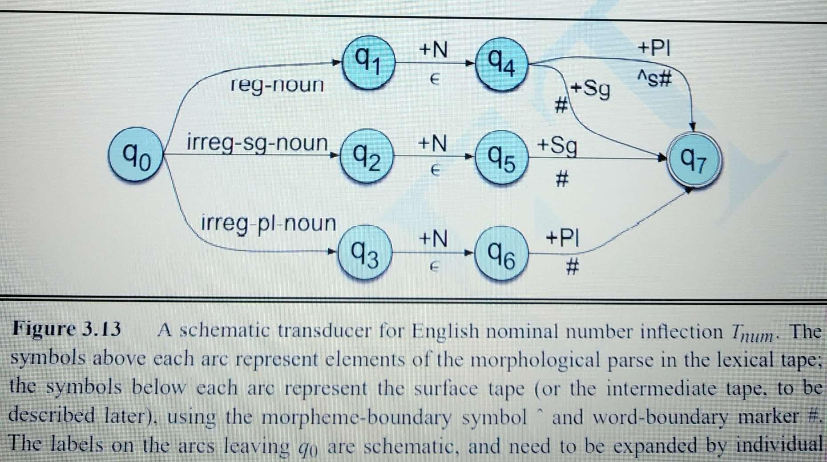
Morphological noun parser
^ - indicates a morpheme boundary # - indicates a word boundary

Slide 47
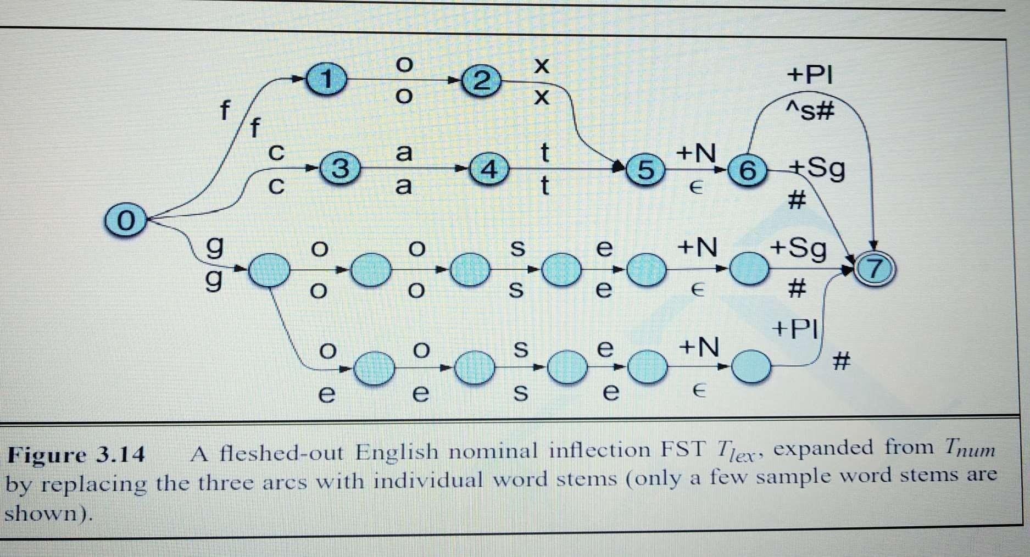

Slide 48
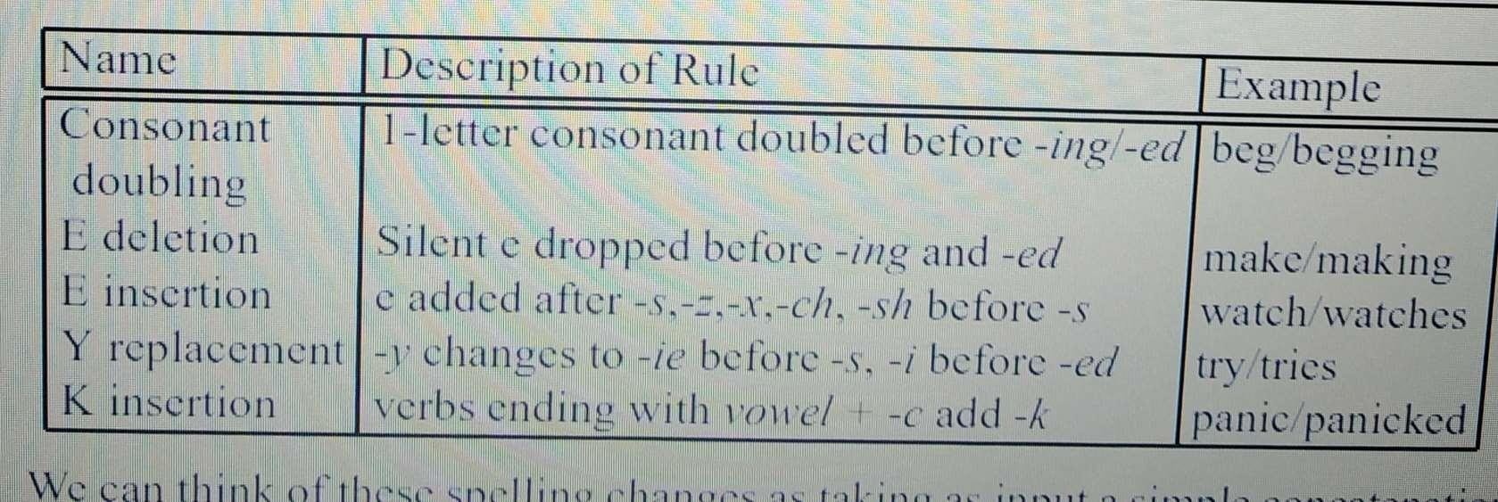
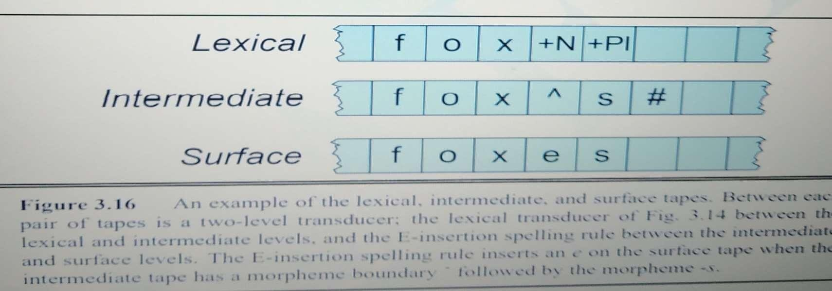
Transducers and Orthographic rules

Slide 49
Part of Speech Tagging
Part of Speech tagging is a process of assigning a PoS or other syntactic class marker to each word in a corpus.
(A corpus is a computer readable collection of text or speech)
Eg Book that flight. Book/VB that/DT flight/NN.
Popular corpora (English): Brown Corpus (1M words) British National Corpus – BNC (100M words)
Wall Street Journal Corpus (30M words)
Here, (Penn Treebank PoS tags) VB – verb, base form
DT – determiner NN – noun, singular
POS is useful for subsequent syntactic parsing and word sense disambiguation

Slide 50
Basic 8 parts-of-speech
noun, verb, pronoun, proposition, adverb, conjunction, participle, article
Penn Treebank (1993) – 45 PoS tags
Brown Corpus (1979) – 87 PoS tags
Parts of speech are also known as word classes, morphological classes, lexical tags
PoS tags are very useful in syntactic parsing, WSD, IR ,…

Slide 51
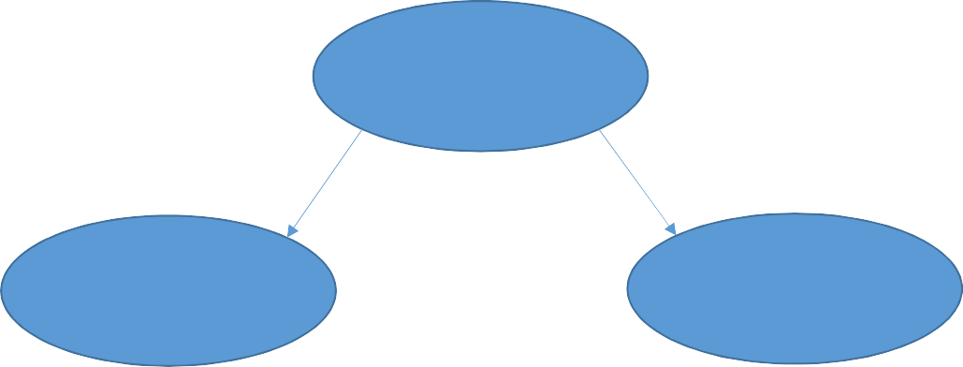
PoS tags - closed class and open class
PoS tags
Closed class
Open class
Relatively fixed membership Eg. Prepositions
New members can be added Eg. Noun, verb
fax, mute

Slide 52
Part of speech is the grammatical category of a word.
Verb asserts something about the subject of the sentence and express actions, events, or states of being. Ex. Walk, write, stand (main form, 3rd person SG, past participle, ….)
Noun is used to name a person, an animal, a place, a thing, or an abstract idea.
Ex. Rama, book, John (common noun, proper noun)
Adjective describes nouns and pronouns by some property or quality. Ex. Beautiful, noisy
Adverb describes a verb, a phrase, or a clause. An adverb indicates manner, time, place,
cause, ... Ex. Slowly, gently (directional, locative, degree, manner, temporal)
Pronoun replaces nouns or another pronouns and are essentially used to make sentences less cumbersome and less repetitive. Ex. He, she, it
Prepositions, Conjunctions, Determiners ...

Slide 53
Closed classes in English
Prepositions – on, under, over, from, to
Determiners – a, an, the
Pronouns – she, I, who
Conjunctions – and, but, or, if
Auxiliary verbs – can, may, should
Particles – up, down, on, off, in, out, at, by
Numerals – one, two, first, forth

Slide 54
Tagsets for English
Origin of all Tagsets for English language is “87-tag tagset” used for Brown Corpus in 1979 – research at Brown university
It is a million word collection of samples from 500 written texts from different genres (news papers, novels, academics, non-fiction, etc)
TagSets
The process of classifying words into their parts of speech and labeling them accordingly is known as part-of-speech tagging, POS-tagging, or simply tagging. Parts of speech are also known as word classes or lexical categories. The collection of tags used for a particular task is known as a tagset.

Slide 55
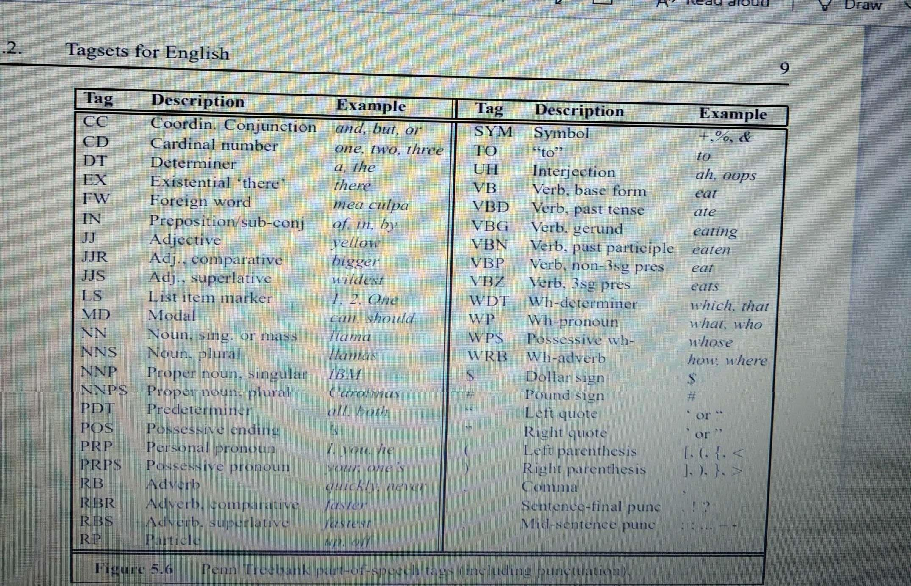
Small 45-tag Penn Treebank Tagset

Slide 56
Ex. The grand jury commented on a number of topics.
Tagging based on small 45-tag Penn Treebank tagset
The – determiner /DT
Grand – adjective /JJ Jury – noun SG /NN
Commented - verb, past /VBD On – preposition /IN
The /DT grand /JJ jury /NN commented /VBD on /IN a /DT number /NN of /IN topics /NNS. /.

Slide 57
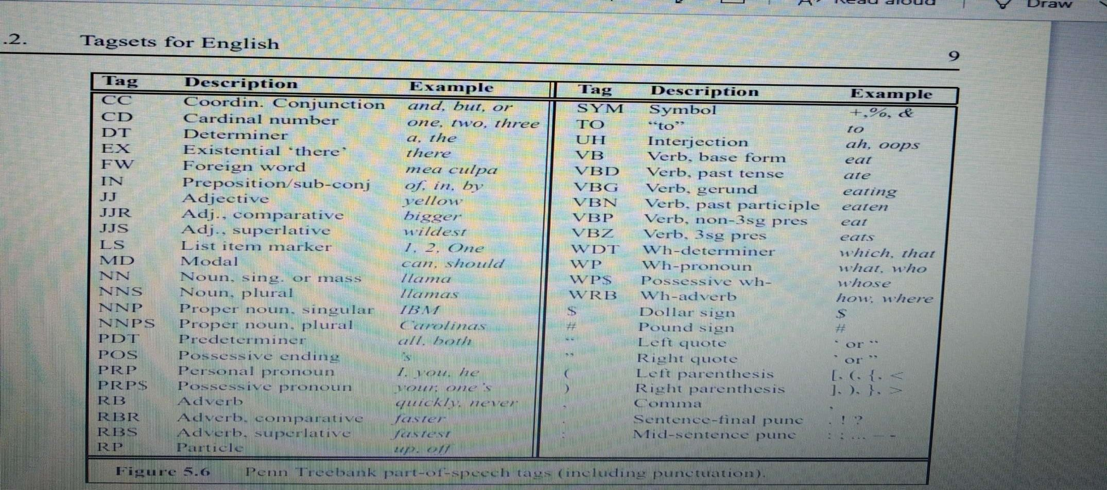
Exercise
A part-of-speech tagger is a piece of software that reads text in some language and decides category.

Slide 58
A /DT
Part-Of-Speech/NNP Tagger/NNP
is/VBZ a/DT
piece/NN of/IN software/NN that/WDT reads/VBZ text/NN in/IN some/DT language/NN

Slide 59
Algorithms for POS tagging
Rule based algorithms – work with a database of hand-written disambiguation rules
-Stage 1 – assigns a potential pos tag to each word using a dictionary uses 2-level transducer to return all possible pos of a word
-Stage 2 – uses a list of hand-written disambiguation rules to narrow down this list to a single pos to each word
Probabilistic / Stochastic taggers – use a training corpus to compute the probability of a given word having a given tag in a given context
[The simplest stochastic taggers disambiguate words based solely on the probability that a
word occurs with a particular tag. ]
eg. HMM tagger

Slide 60
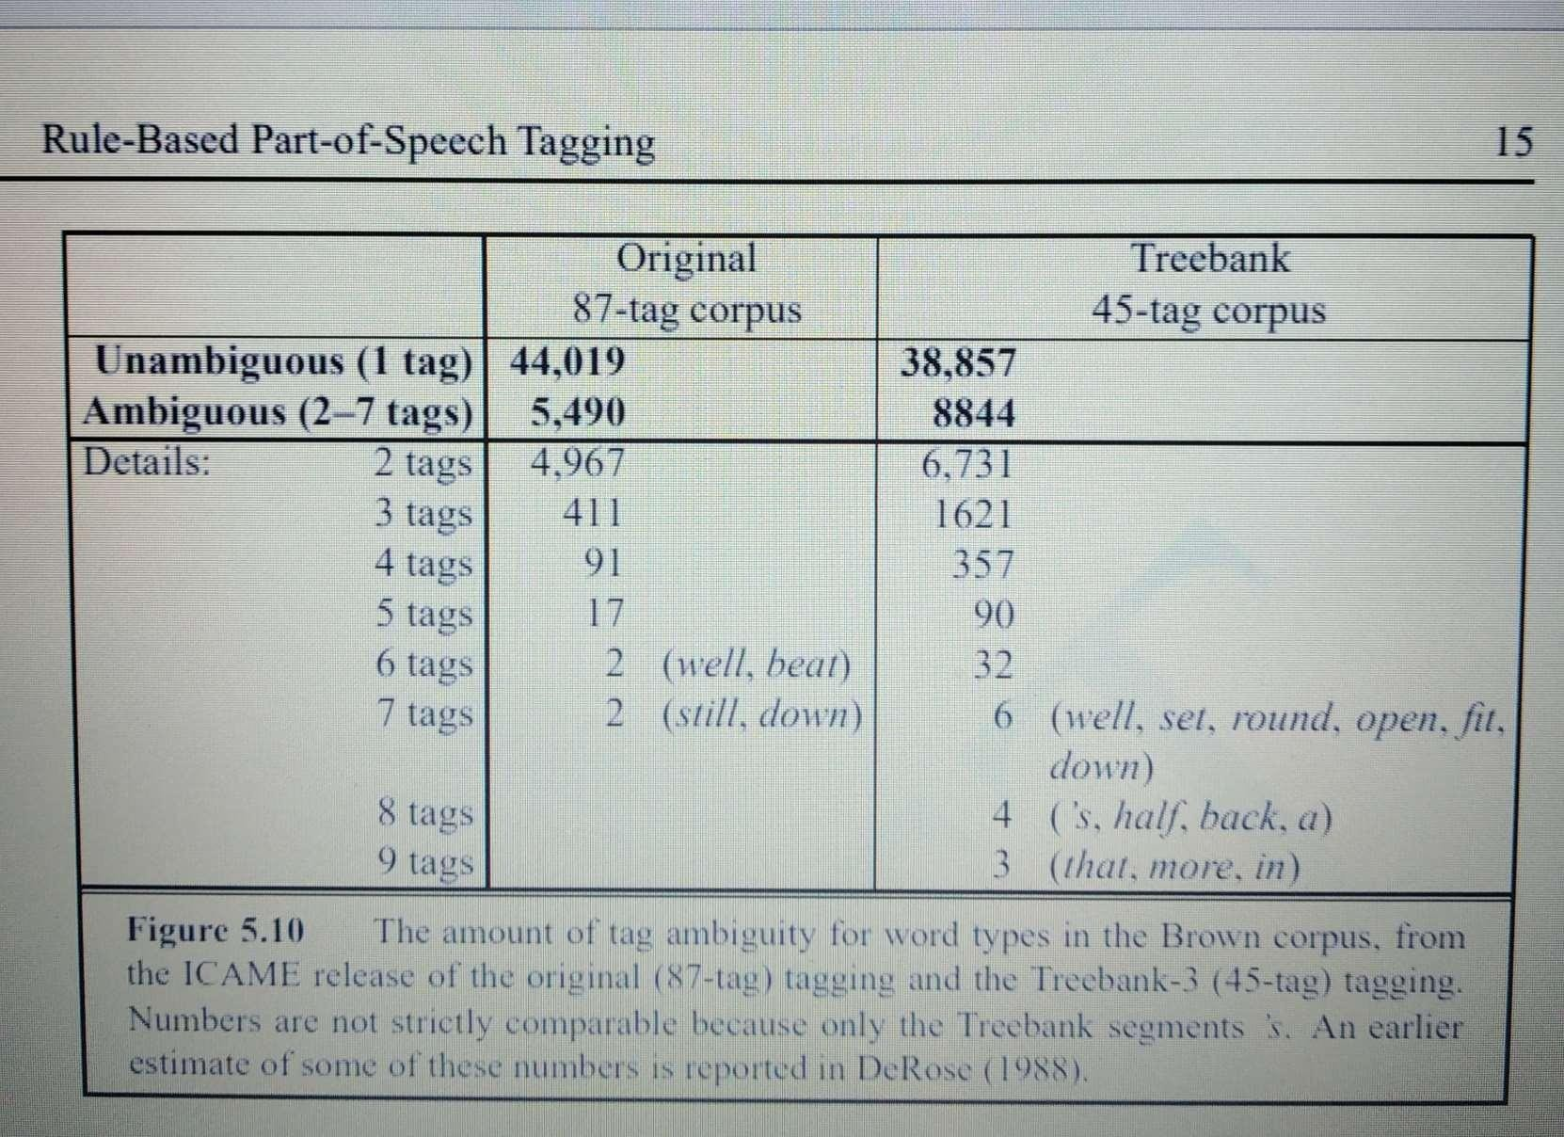
The table below shows the amount of tag ambiguity for word types in the Brown corpus

Slide 61
Named Entities
Named-entity recognition (NER) (also known as (named) entity identification, entity chunking, and entity extraction) is a subtask of information extraction that seeks to locate and classify named entities mentioned in unstructured text into pre-defined categories such as
person names,
organizations,
locations,
medical codes,
time expressions,
quantities,
monetary values,
percentages, etc.

Slide 62
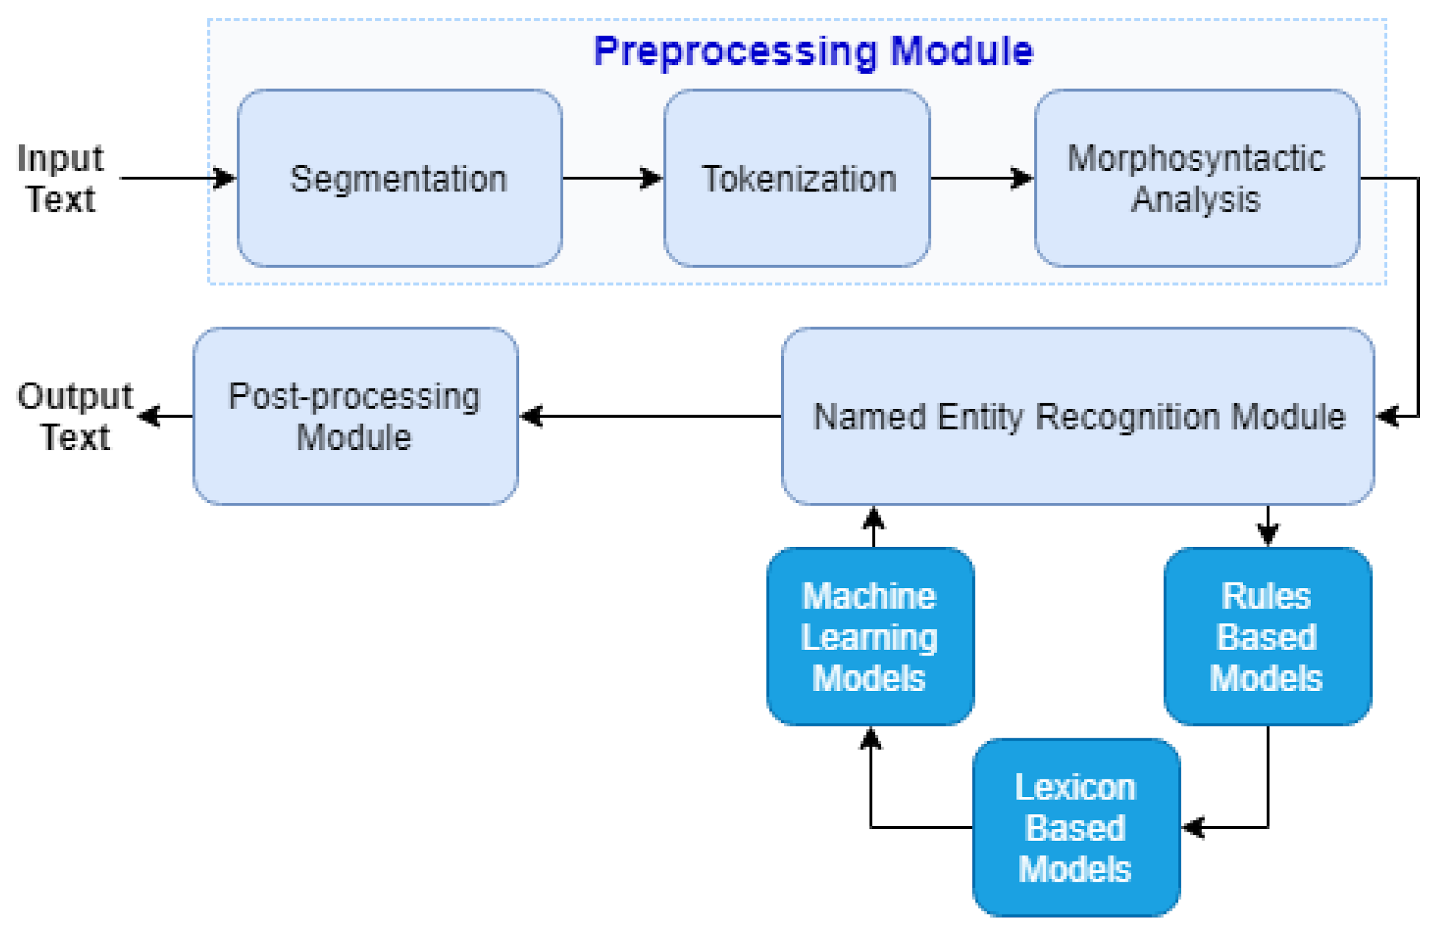
NER

Slide 63
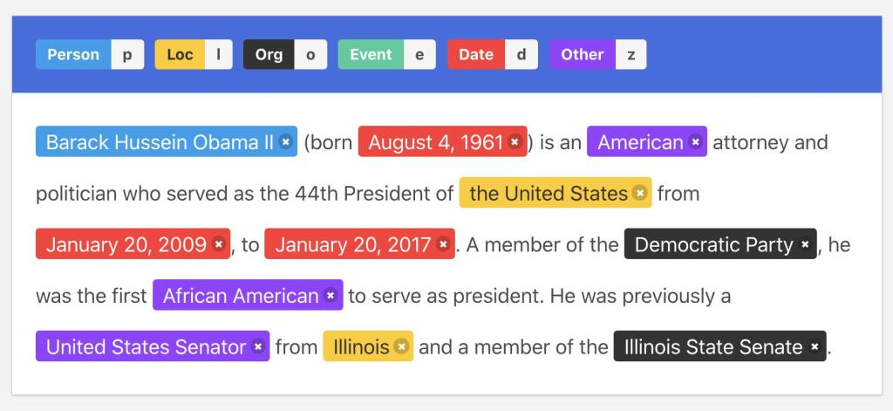
Example of NER

Slide 64
HMM
A statistical model called a Hidden Markov Model (HMM) is used to describe systems with changing un-observable states over time.
It is predicated on the idea that there is an underlying process with concealed states, each of which has a known result.
Probabilities for switching between concealed states and emitting observable symbols are defined by the model.
HMMs are referred to as “hidden” because only the observations themselves are directly visible, not the underlying sequence of states that produced them.
A probability distribution over the potential observations is connected to each state. The model generates an observation according to the probability distribution for the state it is in at each time step.
According to first-order Markov Assumption -The weather condition on the nth day is only dependent on the weather of (n-1)th day. i.e. tomorrow’s weather is only dependent on today’s weather conditions only. This can be mathematically written as:

Slide 65
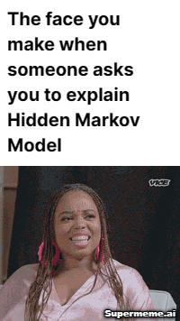
HMM
The Baum-Welch algorithm
Given a set of observations, the Baum-Welch algorithm is an iterative technique for estimating the hidden Markov model’s (HMM) parameters.
The algorithm aims to find the set of model parameters that maximize the likelihood of the observations given to the model.
The probability of each potential hidden state sequence is calculated using the observations and model parameters in the forward step. The backward step determines the likelihood of each observation in light of the hidden state hierarchy and model parameters.
The algorithm aims to find the set of model parameters that maximize the likelihood of the observations given to the model.
The model parameters are then updated using the forward and backward probabilities, which are then used to generate fresh forward and backward probabilities, and so forth. Either a set number of times or until the model’s parameters converge on a stable solution, whichever comes first.
The Baum-Welch algorithm is an example of an expectation-maximization (EM) algorithm, which alternates between maximizing the likelihood of the observations given the estimated values of the hidden variables and calculating the expected value of the hidden variables given the observations.

Slide 66
HMM
The Viterbi algorithm
The Viterbi algorithm is a powerful dynamic programming method for determining the hidden state sequence that is most likely to exist in a hidden Markov model (HMM). The algorithm is frequently used for speech recognition, part-of-speech tagging, and DNA sequence analysis. It is named after its creator, Andrew Viterbi.
Given the model’s observations and parameters, the algorithm calculates the probability of each possible sequence of hidden states in a recursive way.
First, the algorithm computes the chance of each potential state given the previous state and the observation at each time step by considering the previous and current conditions. The current state is then determined to be the one with the highest probability.
The algorithm begins at the first time step and progresses through the observations one at a time, updating the probabilities of the potential sequences along the way. When it gets to the last time step, it picks the hidden state sequence with the highest chance as the most likely one.

Slide 67
HMM Example
Let’s say we want to determine the part of speech tags for each word in the sentence “The cat sat on the mat.” This can be represented as an HMM with observations corresponding to the terms in the sentence and a bunch of states representing the potential parts of speech (POS) tags.
Once trained, the most likely POS tags for a new sentence can be predicted using the HMM. The Viterbi algorithm, which uses the observations to determine the most likely order of hidden states
For instance, the HMM might predict the POS tags “Determiner Noun Verb Preposition Determiner Noun” given the sentence “The cat sat on the mat.”

Slide 68
The hidden Markov Model (HMM) is a statistical model that is used to describe the probabilistic relationship between a sequence of observations and a sequence of hidden states.
It is often used in situations where the underlying system or process that generates the observations is unknown or hidden, hence it has the name “Hidden Markov Model.”
It is used to predict future observations or classify sequences, based on the underlying hidden process that generates the data.
An HMM consists of two types of variables: hidden states and observations.
The hidden states are the underlying variables that generate the observed data, but they are not directly observable.
The observations are the variables that are measured and observed.
The relationship between the hidden states and the observations is modeled using a probability distribution.
The Hidden Markov Model (HMM) is the relationship between the hidden states and the observations using two sets of probabilities: the transition probabilities and the emission probabilities.
The transition probabilities describe the probability of transitioning from one hidden state to another.
The emission probabilities describe the probability of observing an output given a hidden state.

Slide 69
Hidden Markov Model Algorithm
The Hidden Markov Model (HMM) algorithm can be implemented using the following steps:
Step 1: Define the state space and observation space
The state space is the set of all possible hidden states, and the observation space is the set of all possible observations.
Step 2: Define the initial state distribution
This is the probability distribution over the initial state.
Step 3: Define the state transition probabilities
These are the probabilities of transitioning from one state to another. This forms the transition matrix, which describes the probability of moving from one state to another.
Step 4: Define the observation likelihoods:
These are the probabilities of generating each observation from each state. This forms the emission matrix, which describes the probability of generating each observation from each state.

Slide 70
Hidden Markov Model Algorithm
Step 5: Train the model
The parameters of the state transition probabilities and the observation likelihoods are estimated using the Baum-Welch algorithm, or the forward-backward algorithm. This is done by iteratively updating the parameters until convergence.
Step 6: Decode the most likely sequence of hidden states
Given the observed data, the Viterbi algorithm is used to compute the most likely sequence of hidden states. This can be used to predict future observations, classify sequences, or detect patterns in sequential data.
Step 7: Evaluate the model
The performance of the HMM can be evaluated using various metrics, such as accuracy, precision, recall, or F1 score.

Slide 71
Hidden Markov Model’s advantages and disadvantages for NLP?
PROs:
HMMs are used a lot and have been extensively studied. There are algorithms for training and decoding that work well.
For tasks like part-of-speech tagging and named entity recognition, where the context of a word in a sentence is crucial, HMMs can be used to model sequential data.
With the help of probabilities, HMMs can include more things, like linguistic context or data from the outside world.
CONs:
HMMs assume that the observations are independent, which is often not true in NLP tasks because of the hidden states.
Long-range dependencies can be problematic for HMMs to handle, and they sometimes need help understanding the context of a word in a sentence entirely.
HMMs may need to be tuned carefully to work well because how the initial model parameters are chosen can affect how well they work.
The hidden Markov Model can be helpful for NLP tasks, but they are not always the most effective or flexible method. Other methods, like recurrent neural networks, may be better for some functions or data sets.

Slide 72
The Hidden Markov Model’s Applications in NLP?
Part-of-speech tagging: Using the word order and the POS tags of words around it, HMMs can predict the part-of-speech tag for each word in a sentence.
Named entity recognition: Named entities in text, such as names of people, places, or organizations, can be found using HMMs.
HMMs can turn spoken language into text by simulating the probability distribution of speech sounds given the words being spoken.
HMMs can translate text from one language to another by simulating the probability distribution of words in the target language given the words in the source language.
Language modelling: Using the previous words in a sequence as a guide, HMMs can predict the following word. This can enhance the efficiency of language processing tasks like text generation and spelling checking.

Slide 73

Research at IITB

Slide 74
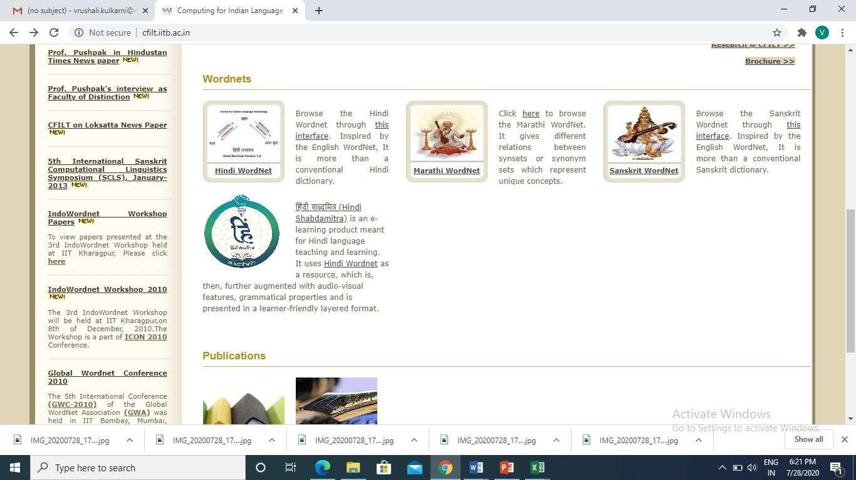

Slide 75
Parsing / Syntax Analysis
Given a string of terminals and a CFG, determine if the string can be generated by the CFG.
Also return a parse tree for the string
return all possible parse trees for the string
Must search space of derivations for one that derives the given string.
– Top-Down Parsing: Start searching space of derivations for the start symbol.
– Bottom-up Parsing: Start search space of reverse derivations from the terminal
symbols in the string.

Slide 76
Parsing
Syntactic Parsing - Produce the correct syntactic parse tree for a sentence.
Context Free Grammars (CFG) = {N, Σ, R, S}
N a set of non-terminal symbols (or variables)
Σ a set of terminal symbols (disjoint from N)
R a set of productions or rules of the form A→β,
where A is a non-terminal and β is a string of symbols from (Σ N)*
S, a designated non-terminal called the start symbol

Slide 77
Example of CFG
Grammar
S → NP VP
S → Aux NP VP
S → VP
NP → Pronoun
NP → Proper-Noun NP → Det Nominal Nominal → Noun
Nominal → Nominal Noun Nominal → Nominal PP VP → Verb
VP → Verb NP
VP → VP PP
PP → Prep NP
Lexicon
Det -> the|a|that|this
Noun -> book |flight| money
Verb -> book | prefer |include Pronoun -> I | he | she | me Proper-Noun -> Pune | Mumbai Aux -> does
Prep -> from | to |on | near | through

Slide 78
Sentences are generated by recursively rewriting the start symbol using the productions until only terminals symbols remain.
Ex. - book the flight from Mumbai
Start
VP
Verb
NP
book
Det
Nominal
the
Nominal
PP
Noun flight
Prep from
NP
Proper-Noun
Mumbai

Slide 79
The miniature English grammar and lexicon
Grammar
S → NP VP
S → Aux NP VP S → VP
NP → Pronoun
NP → Proper-Noun
NP → Det Nominal Nominal → Noun
Nominal → Nominal Noun Nominal → Nominal PP VP → Verb
VP → Verb NP VP → Verb NP PP
VP → Verb PP VP → VP PP
PP → Preposition NP
Lexicon
Det -> the a that this
Noun -> book flight money Verb -> book prefer include Pronoun -> I he she me we
Proper-Noun -> Pune Mumbai Hyderabad Aux -> does
Preposition -> from to on near through
Exercise
Parse following sentences
Does American airlines serves a meal? She plays in the garden.
Top-down Bottom-up

Slide 80
Does American airlines serves a meal?
(top-down parse)
S
Aux
NP
VP
Does
proper Noun
VP
PP
American Airlines
verb
Det NP
serves
a
meals

Slide 81
Bottom-up parse
She plays in the garden.
NP | VP |  |  | Nominal
Pronoun | verb | Preposition | Det | Noun
She | plays | in | the | garden

Slide 82
NP
NP
VP
Nominal
Pronoun
verb
Preposition
Det
Noun
She
plays
in
the
garden

Slide 83
S
VP
PP
NP
NP
VP
Nominal
Pronoun
verb
Preposition
Det
Noun
She
plays
in
the
garden

Slide 84
Ambiguity
Present at various phases
Lexical level – pos tagging
ex. Book that flight. Book as Noun or Verb – Rule based algo, WSD
Syntactic Level –
ambiguity rises in syntactic structures – structural ambiguity multiple parse trees are possible for the same sentence
Syntactic ambiguity
attachment ambiguity
coordination ambiguity

Slide 85
Attachment ambiguity
This ambiguity exists if a particular constituent can be attached to the parse tree at more than one places.
Ex. I saw the man with a telescope.

Slide 86
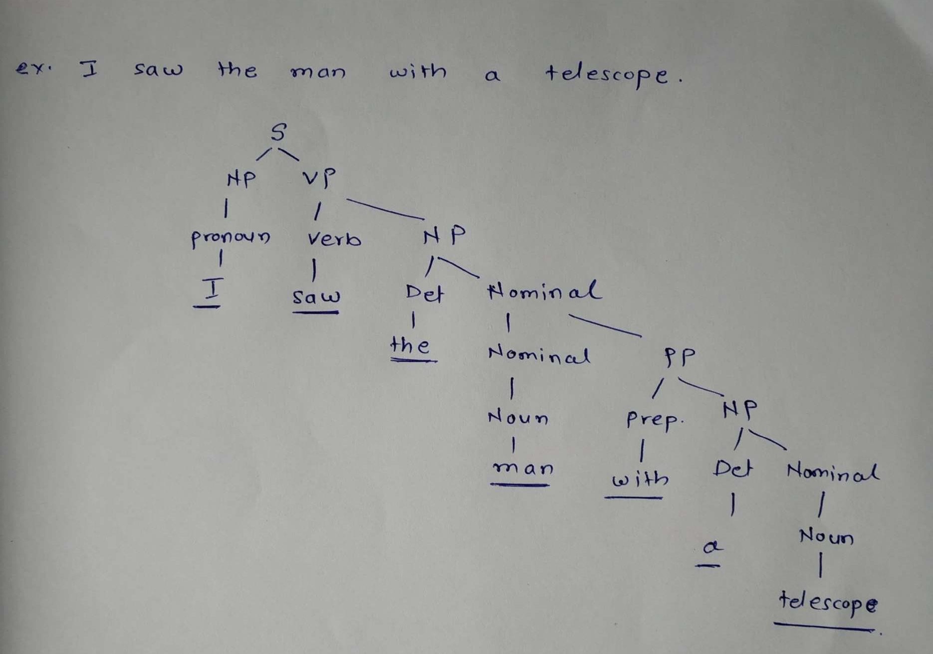
One of the possible parse trees

Slide 87
Attachment ambiguity
This ambiguity exists if a particular constituent can be attached to the parse tree at more than one places.
Ex. I saw the man with a telescope. I saw the man with a telescope.

Slide 88
“Guna ate an ice cream with fruits from Chennai”
In this sentence, we have two prepositional phrases “with fruits” and “from Chennai”.
Here the possible meanings are as follows;
1. Guna who is from Chennai ate an ice cream filled with fruits.
2.Guna ate an ice cream filled with fruits and the ice cream is brought from Chennai.
3.Guna who is from Chennai ate the ice cream with the help of fruits.
4. Guna with the help of fruits ate the ice cream which is brought from Chennai
Here we got four possibilities due to two prepositional phrases. Each one arises from how we attach the prepositional phrases “with fruits” and “from Chennai” to either “Guna” or the “ice cream”.

Slide 89
I saw the man on the hill with a telescope.
I saw the man on the hill with a telescope.
I saw the man on the hill with a telescope

Slide 90
Attachment ambiguity arises from uncertainty of attaching a phrase or clause to a part of a sentence

Slide 91
Coordination ambiguity
This ambiguity exists when different sets of phrases are combined by a conjunction like
“and”
Ex. Old men and women, young boys and girls
→ (old men) and (women)
→ old (men and women)

Slide 92
“delicious cookies and milk”
could mean
ⓐ “delicious cookies” + “milk”
Or
ⓑ “delicious cookies” + “delicious milk”

Slide 93
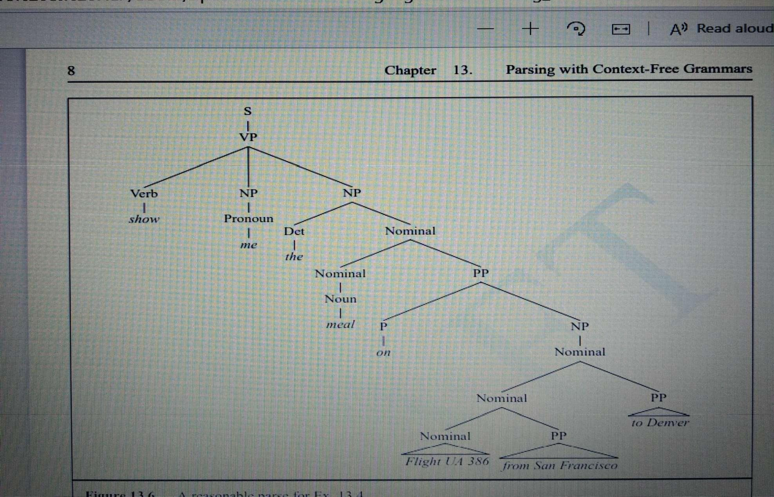
Ex. Show me the meal on Flight UA 386 from San Francisco to Denver. Total 14 parse for this statement – tree below shows a reasonable parse

Slide 94
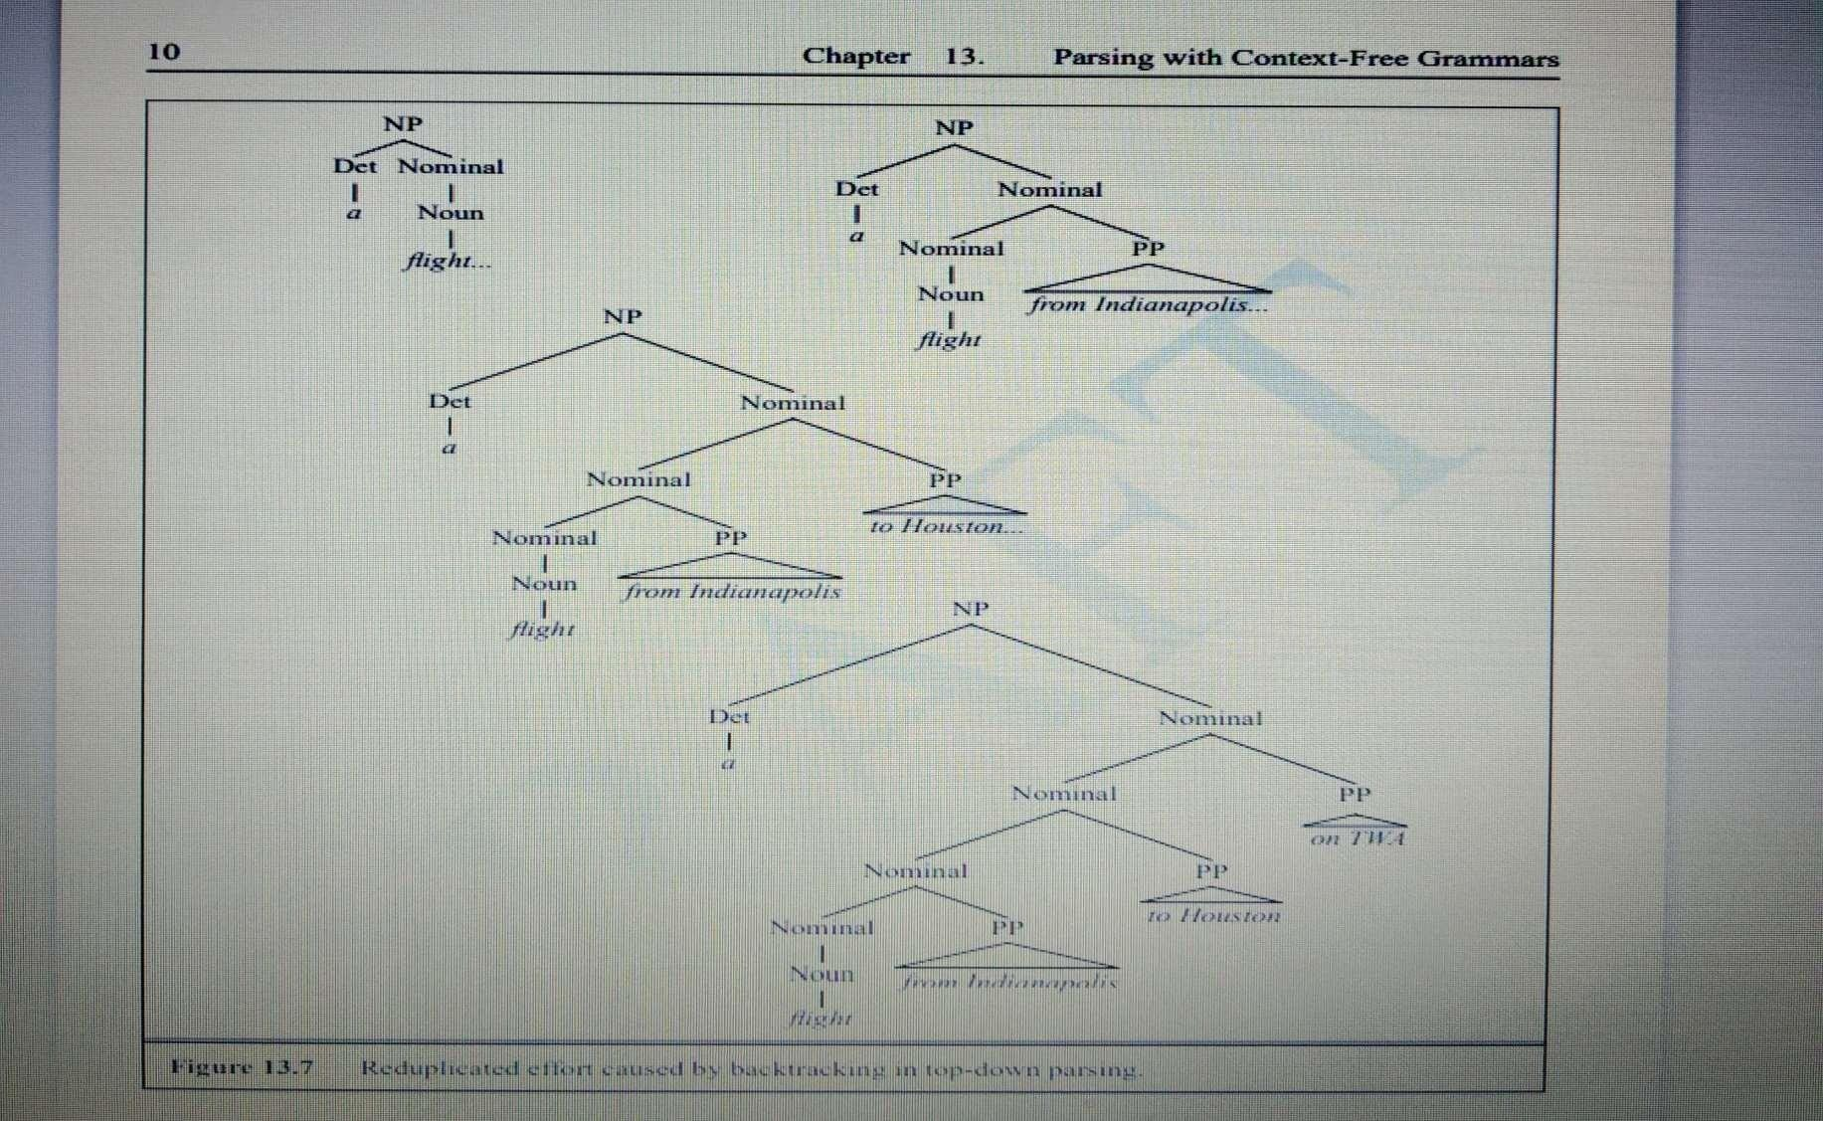
Disambiguation -
Explore all possible parse trees in parallel …. Unrealistic based on memory requirement
Use backtracking strategy – expand the search –space tree by exploring one state at a time and backtrack if required. Inefficient as many subtrees to be rebuilt.

Slide 95
EFFICIENT PARSING FOR CONTEXT FREE GRAMMAR

Slide 96
Dynamic programming parsing methods
Dynamic programming is based on Principle of Optimality. It systematically solves sub-problems and stores intermediate results – no work duplication
In parsing with Dynamic programming, the subtrees are computed once, stored (in tables) and reused.
CKY parsing – uses CNF grammar
The Early algorithm – CFG
Chart parsing – CFG

Slide 97
What is CKY in NLP?
CKY means Cocke-Kasami-Younger.
It is one of the earliest recognition and parsing algorithms.
The standard version of CKY can only recognize languages defined by context-free grammars in Chomsky Normal Form (CNF).
In its simplest form, the CYK algorithm solves the recognition problem; it determines whether a string can be derived from a grammar .
In other words, the algorithm takes a sentence and a context-free grammar and returns TRUE if there is a valid parse tree or FALSE otherwise

Slide 98
Partial Parsing
Many language processing tasks do not require complete parse trees to be generated
…..complete parse tree is a complex process
Partial parse or shallow parse is generated
Ex. Information extraction, Information retrieval
Chunking – one of the ways of performing partial parsing
Finite state Rule based chunking
Machine Learning-based chunking

Slide 99
Shallow parsing (also chunking or light parsing) is an analysis of a sentence which first identifies constituent parts of sentences (nouns, verbs, adjectives, etc.) and then links them to higher order units that have discrete grammatical meanings (noun groups or phrases, verb groups, etc.).
Chunking is used to get the required phrases from a given sentence. However, POS tagging can be used only to spot the parts of speech that every word of the sentence belongs to.
When we have loads of descriptions or modifications around a particular word or the phrase of our interest, we use chunking to grab the required phrase alone, ignoring the rest around it. Hence, chunking paves a way to group the required phrases and exclude all the modifiers around them which are not necessary for our analysis. Summing up, chunking helps us extract the important words alone from lengthy descriptions. Thus, chunking is a step in information extraction.

Slide 100
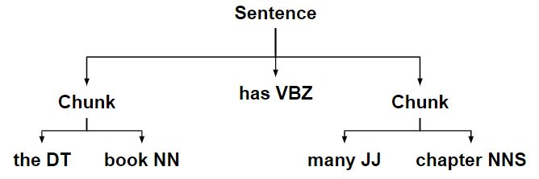

Slide 101
Statistical Parsing
Statistical /Probabilistic parsing helps to solve the problem of disambiguation
Compute the probability of each possible interpretation and choose the most probable interpretation
Most of the modern parsers in NLP are probabilistic
Probabilistic parsers use Probabilistic / Stochastic CFG (PCFG)
- augmenting CFG with probabilities
In PCFG, each production rule will be of the form
A -> β
[p] ……………… p is prob that NT A will be expanded to β
p is a number between 0 and 1

Slide 102
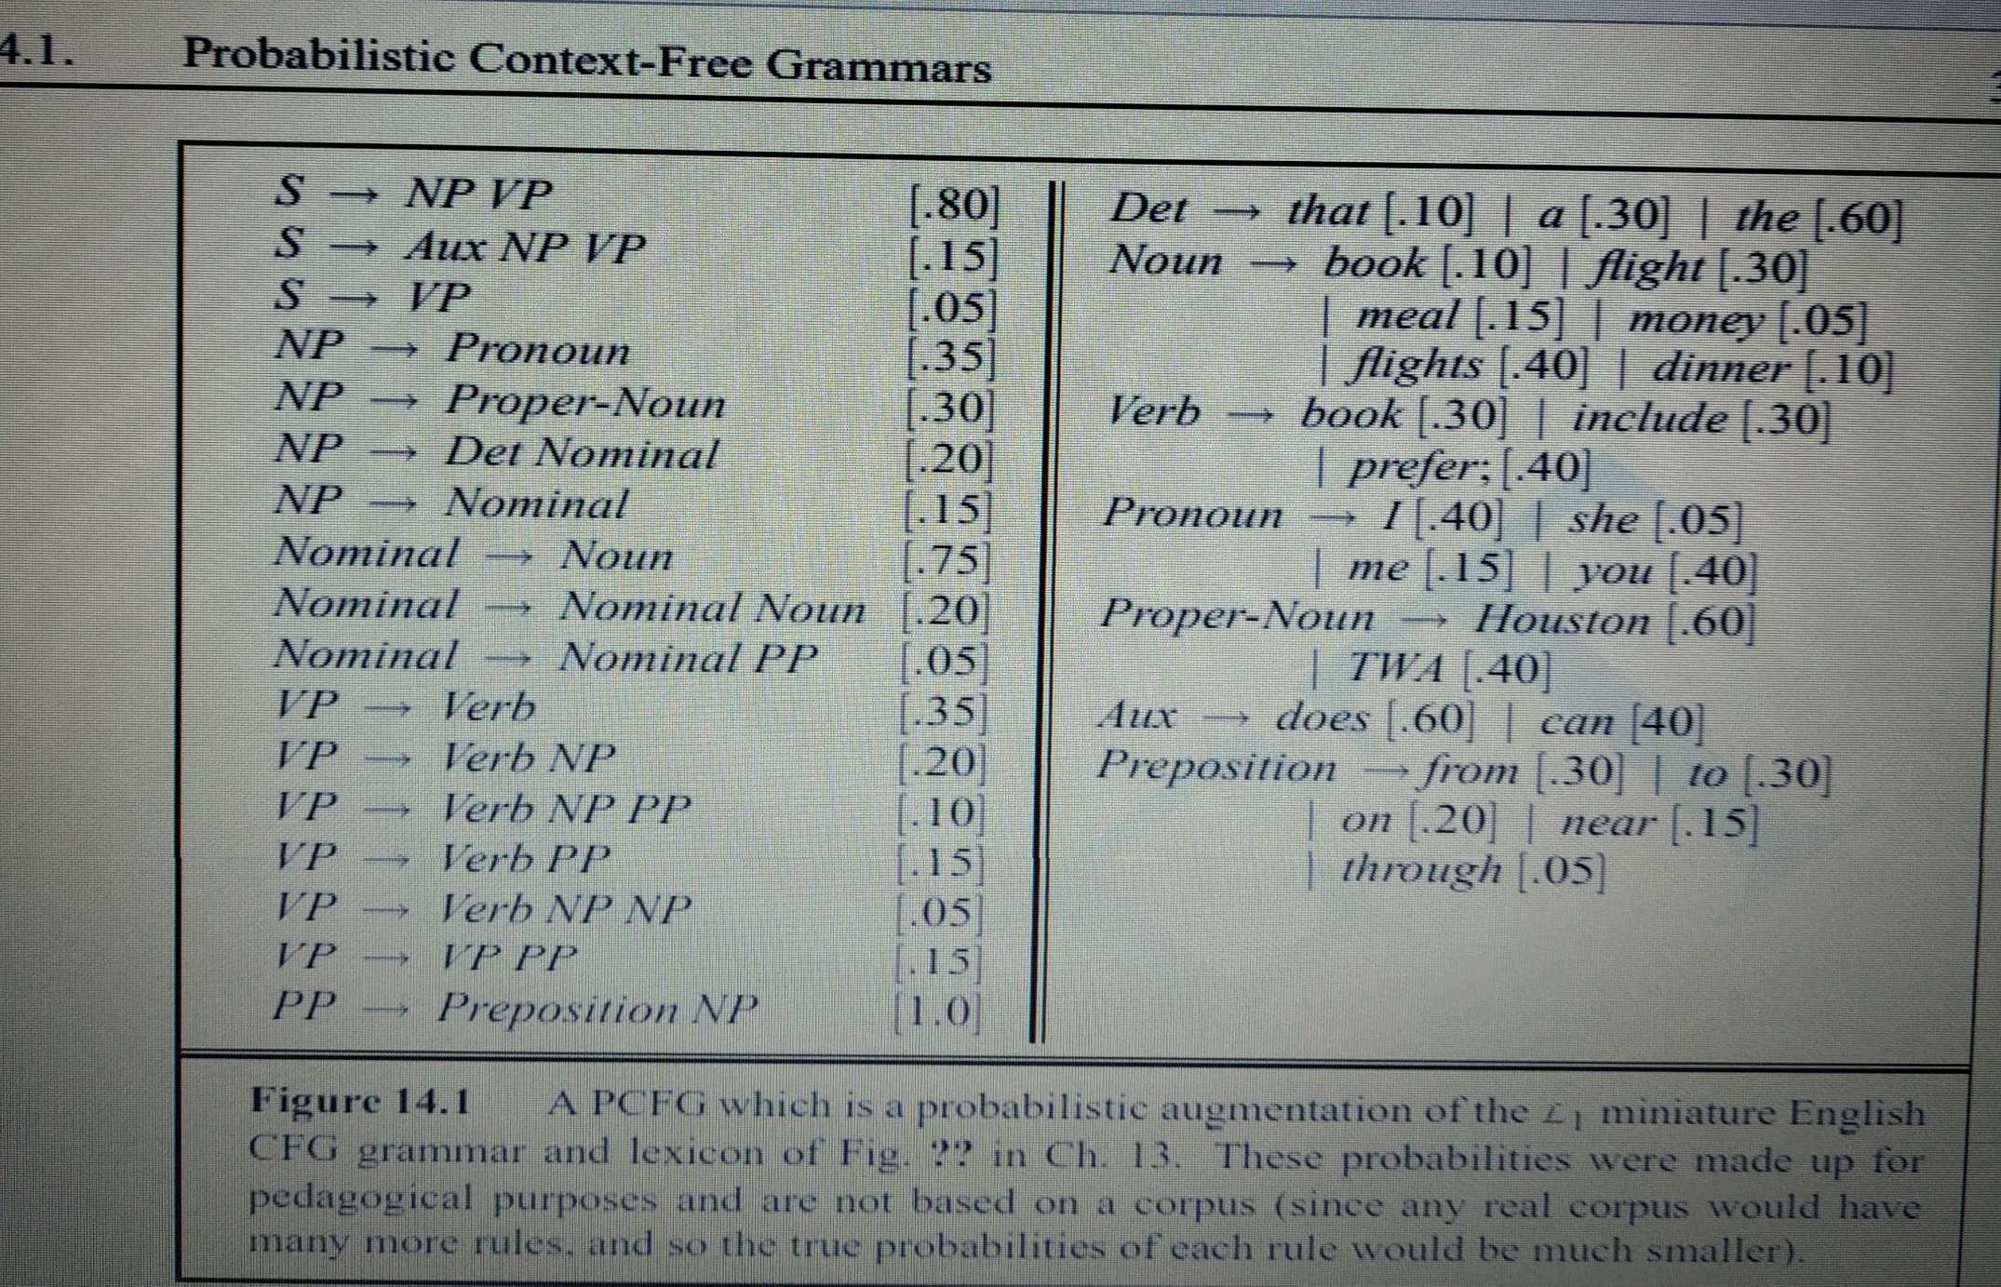
PCFG

Slide 103



Disambiguation with PCFGs
PCFG assigns probability to each parse tree (ie. Each derivation) of a sentence S
The probability of a particular parse T is defined as a product of the probabilities of all
the n rules used to expand each of the non-terminal nodes in the parse tree T,
where each rule i can be expressed as LHS_{i} = RHS_{i}
P(T, S) =
n
i=1
Refer figure for ex statement “Book the dinner flight”

Slide 104
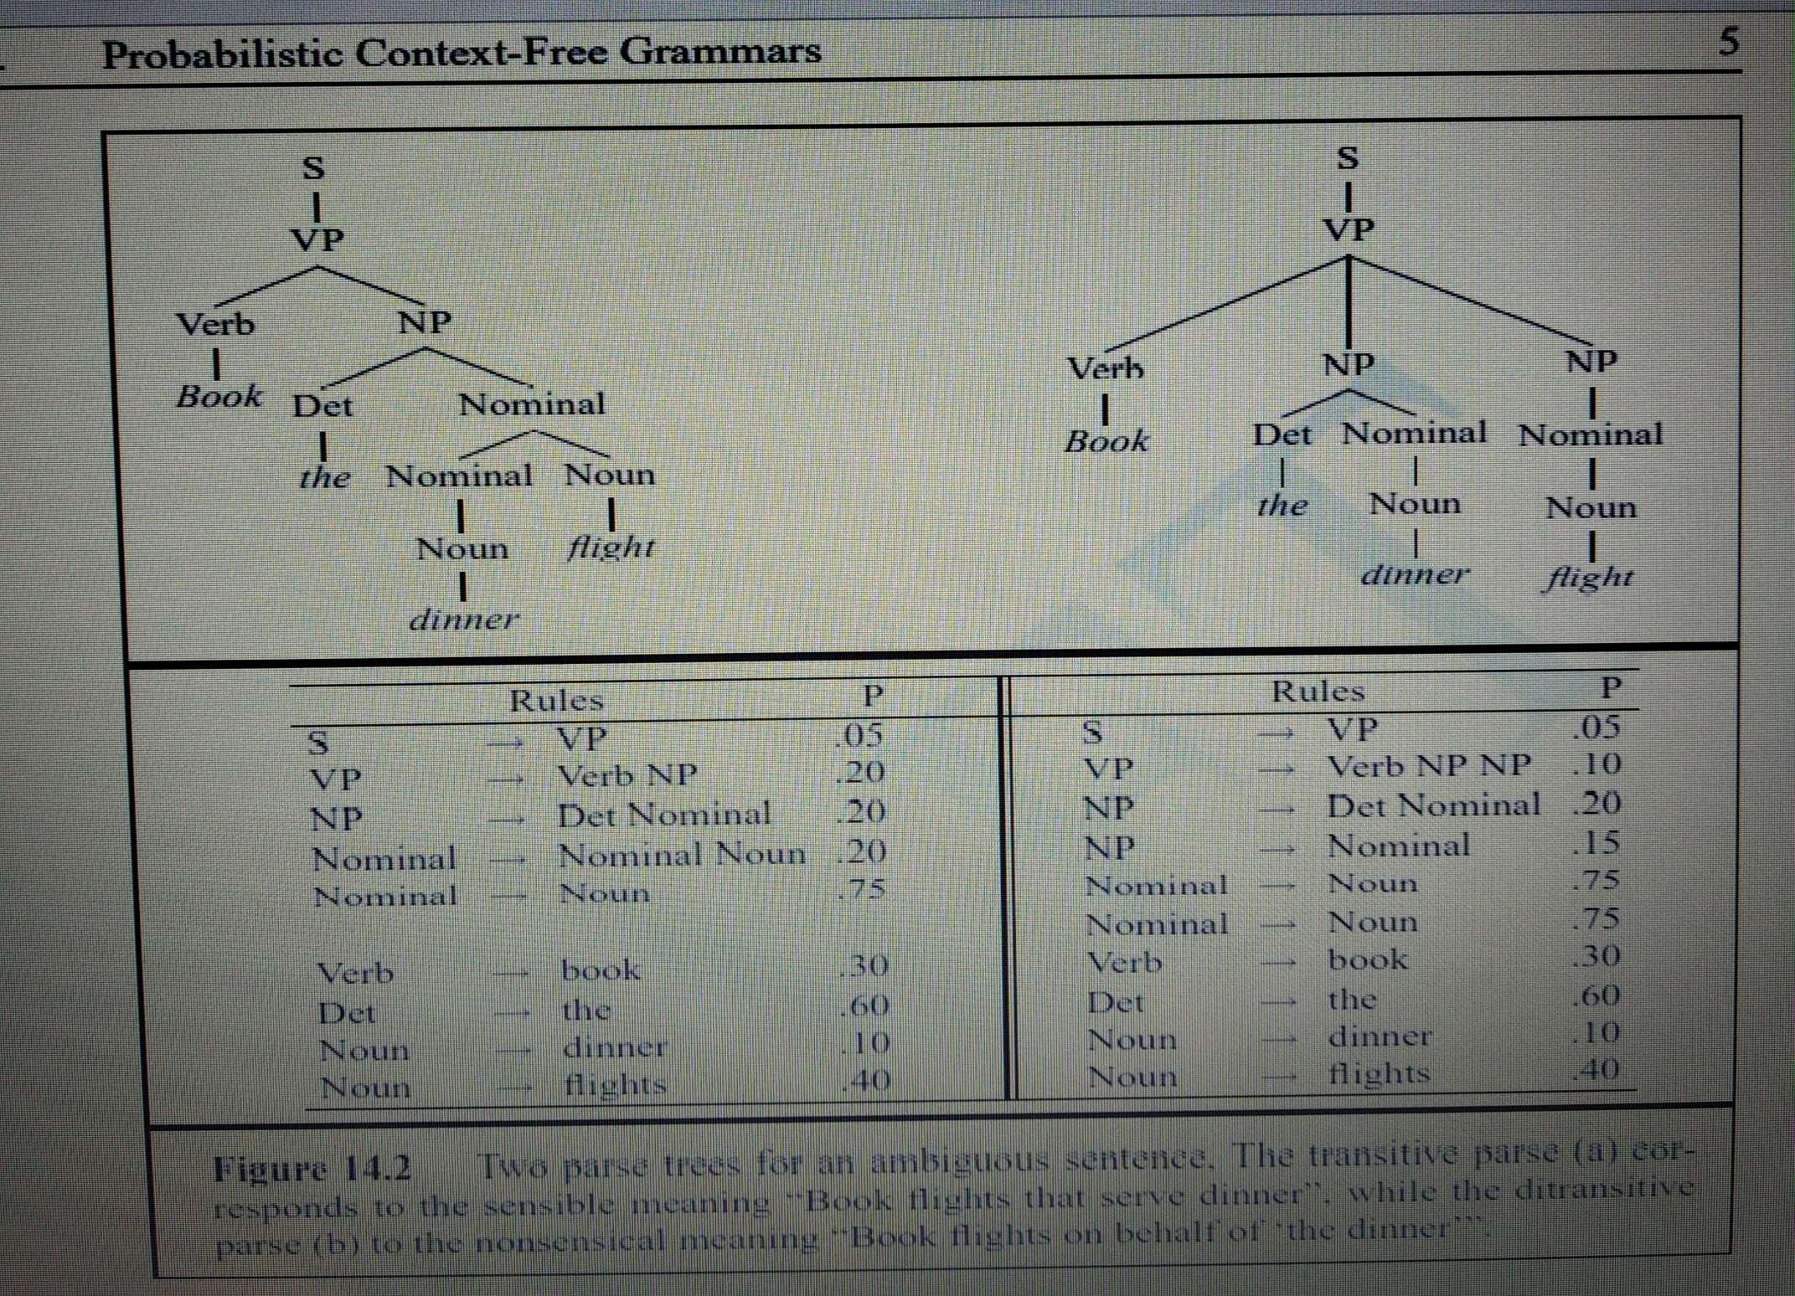

Slide 105
PoS Tagging using
Hidden Markov Model (HMM)

Slide 106
1) An easy introduction to Hidden Markov Model (HMM) - Part 1
https://www.youtube.com/watch?v=YlL0YARYK-o
2) https://www.youtube.com/watch?v=7ak1_zDUgEg

Slide 107
Extra reading material :
PPT on HMM

Slide 108
TreeBank: A data driven approach to Syntax
What is the meaning of treebank?
treebank (plural treebanks) A database of sentences which are annotated with syntactic information, often in the form of a tree.
A treebank can be defined as a linguistically annotated corpus that includes some grammatical analysis beyond the part-of-speech level

Slide 109
What is treebank dataset?
English Web Treebank is a dataset containing 254,830 word-level tokens and 16,624 sentence-level tokens of webtext in 1174 files annotated for sentence- and word-level tokenization, part-of-speech, and syntactic structure

Slide 110
SUSANNE Corpus (Sampson 1995), where each token is represented by one line, with part-of-speech (including morphosyntactic features) in the first column, the actual token in the second column, and the lemma in the third column

Slide 111
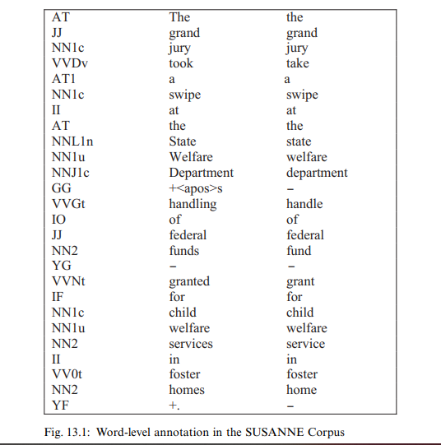

Slide 112
Treebank development
The methods and tools for treebank development have evolved considerably from the very first treebank projects, where all annotation was done manually, to the present-day situation, which is characterized by a more or less elaborate combination of manual work and automatic processing, supported by emerging standards and customized software tools

Slide 113
Tools and Standards
Many of the software tools that are used in treebank development are tools that are needed in the development of any annotated corpus, such as tokenizers and part-of speech taggers.
Tools that are specific to treebank development are primarily tools for syntactic preprocessing and specialized annotation tools.

Slide 114
Well-known examples of syntactic parsers used in treebank development are the deterministic Fidditch parser (Hindle 1994), used in the development of the Penn Treebank, and the statistical parser of Collins et al. (1999), used for the Prague Dependency Treebank.
It is also common to use partial parsers (or chunkers) for syntactic preprocessing, since partial parsing can be performed with higher accuracy than full parsing

Slide 115
References
https://www.ibm.com/in-en/topics/natural-language-processing

Slide 116
END OF UNIT 2

